Slide 1
CSE 417T Introduction to Machine Learning
Lecture 16 Instructor: Chien-Ju (CJ) Ho

Slide 2
Logistics
Homework 4 is due November 14 (Monday)
Keep track of your own late days
Gradescope doesn’t allow separate deadlines
Your submissions won’t be graded if you exceed the late-day limit

Slide 3
Recap

Slide 4
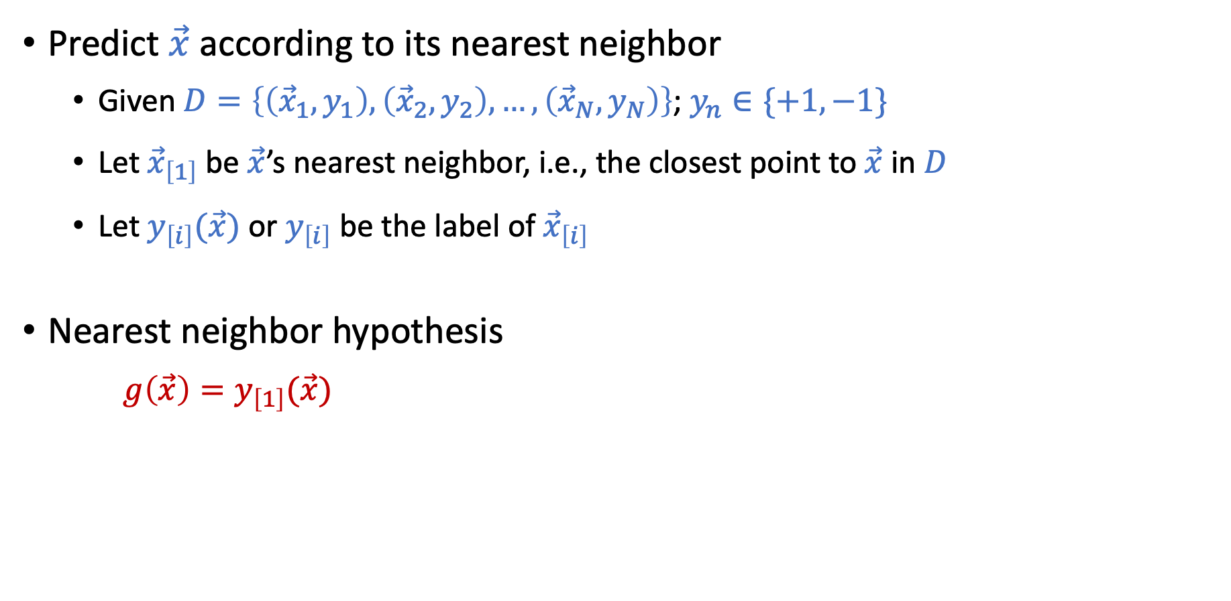
Nearest Neighbor
Predict $\vec{x}$ according to its nearest neighbor
Given $D=\left\{\left({\vec{x}}_{1},y_{1}\right),\left({\vec{x}}_{2},y_{2}\right),…,\left({\vec{x}}_{N},y_{N}\right)\right\}$; $y_{n}∈\{+1,−1\}$
Let ${\vec{x}}_{\left[1\right]}$ be $\vec{x}$’s nearest neighbor, i.e., the closest point to $\vec{x}$ in $D$
Let $y_{\left[i\right]}(\vec{x})$ or $y_{\left[i\right]}$ be the label of ${\vec{x}}_{\left[i\right]}$
Nearest neighbor hypothesis $g\left(\vec{x}\right)=y_{\left[1\right]}(\vec{x})$

Slide 5
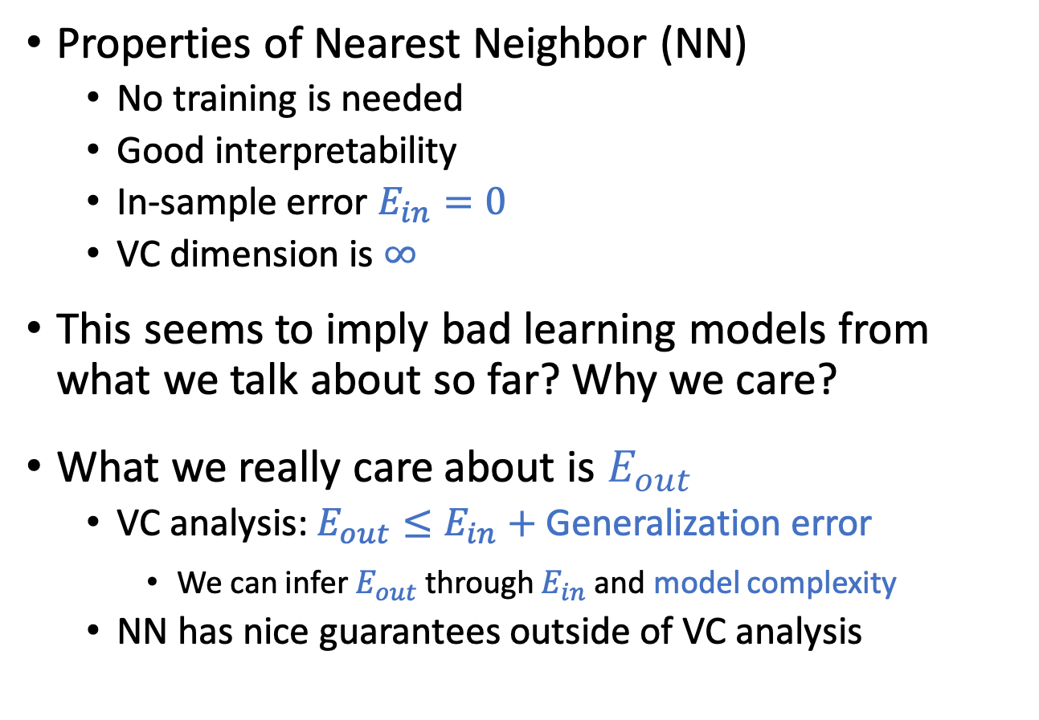
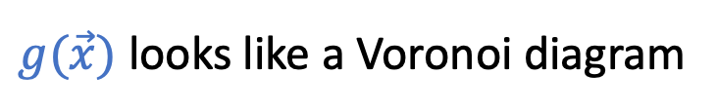
Nearest Neighbor
Properties of Nearest Neighbor (NN)
No training is needed
Good interpretability
In-sample error $E_{in}=0$
VC dimension is $∞$
This seems to imply bad learning models from what we talk about so far? Why we care?
What we really care about is $E_{out}$
VC analysis: $E_{out}≤E_{in}+$ Generalization error
We can infer $E_{out}$ through $E_{in}$ and model complexity
NN has nice guarantees outside of VC analysis
$g(\vec{x})$ looks like a Voronoi diagram

Slide 6
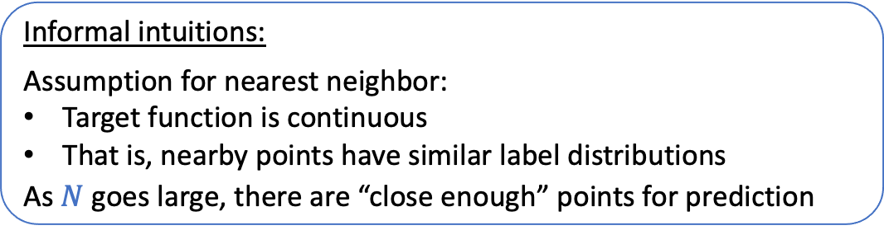
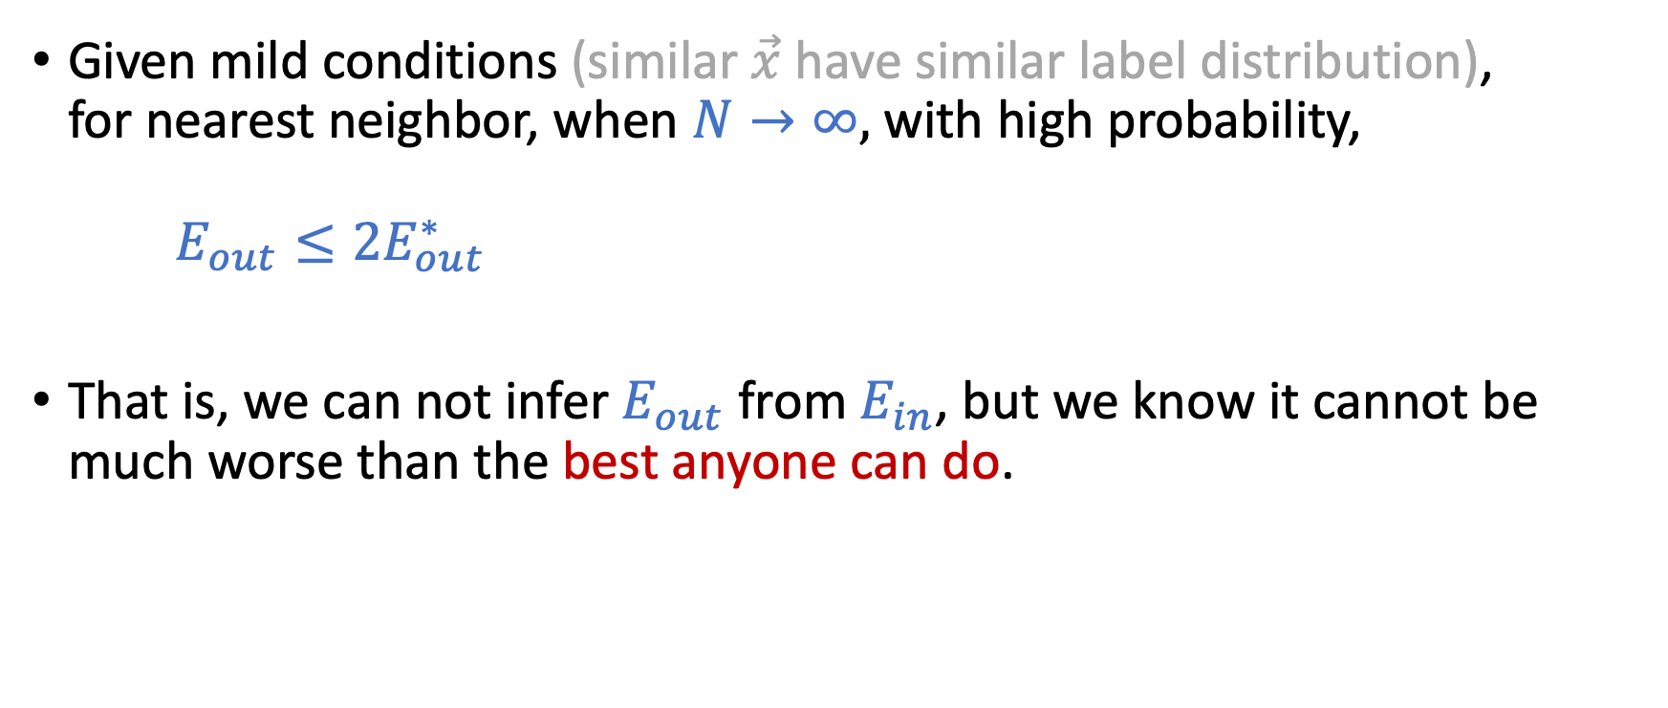
Nearest Neighbor is 2-Optimal
Given mild conditions (similar $\vec{x}$ have similar label distribution), for nearest neighbor, when $N→∞,$ with high probability, $E_{out}≤2E_{out}^{∗}$
That is, we can not infer $E_{out}$ from $E_{in}$, but we know it cannot be much worse than the best anyone can do.
Informal intuitions:
Assumption for nearest neighbor:
Target function is continuous
That is, nearby points have similar label distributions
As $N$ goes large, there are “close enough” points for prediction

Slide 7
Today’s Lecture
The notes are not intended to be comprehensive. They should be accompanied by lectures and/or textbook.
Let me know if you spot errors.

Slide 8
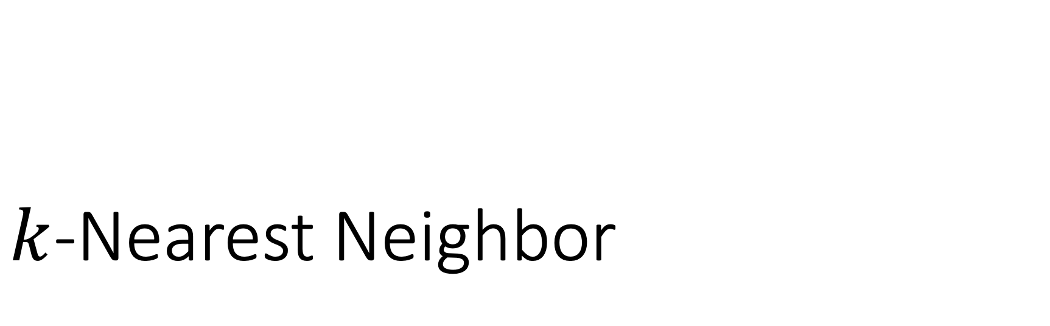
$k$-Nearest Neighbor

Slide 9
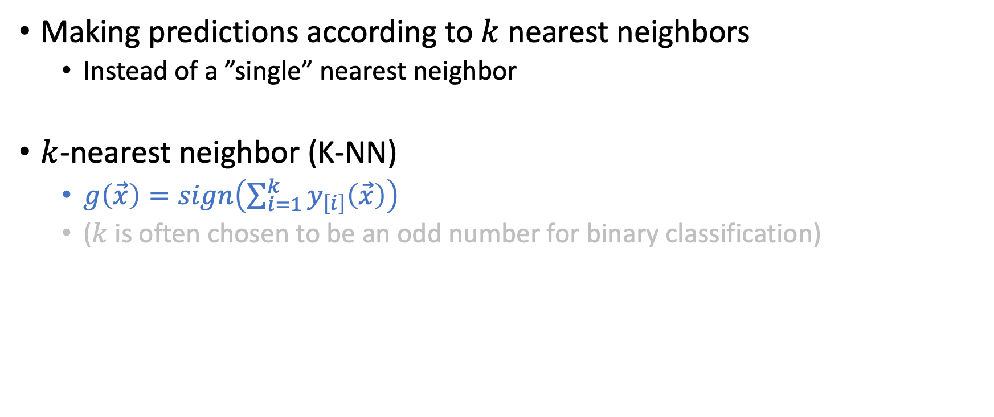
”Stabilize” the Hypothesis
Making predictions according to $k$ nearest neighbors
Instead of a ”single” nearest neighbor
$k$-nearest neighbor (K-NN)
$g\left(\vec{x}\right)=sign\left(\sum_{i=1}^{k}{y_{\left[i\right]}\left(\vec{x}\right)}\right)$
($k$ is often chosen to be an odd number for binary classification)

Slide 10
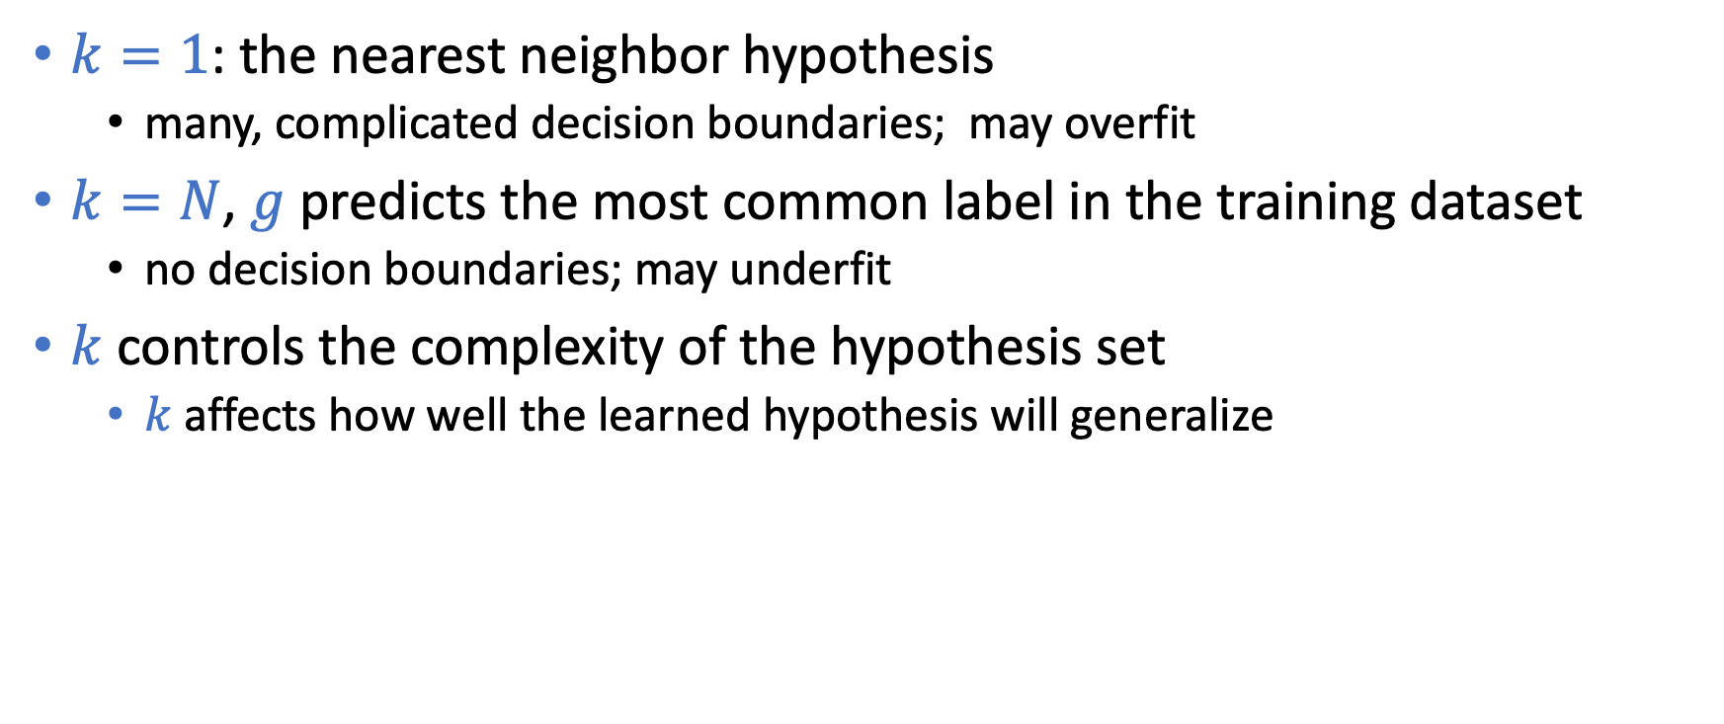
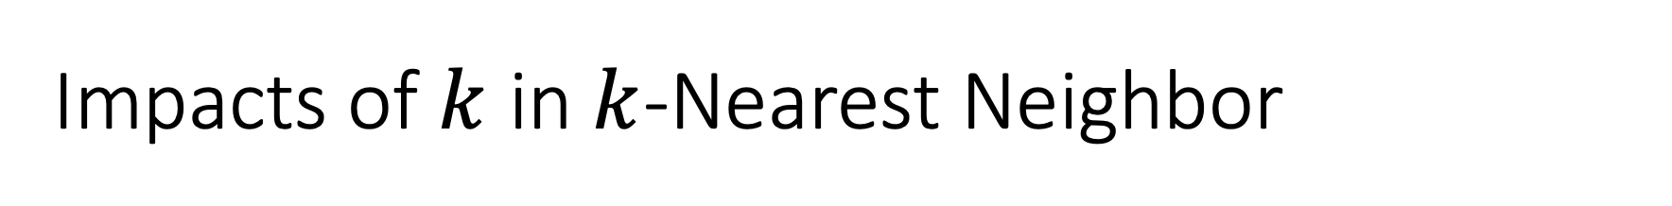
Impacts of $k$ in $k$-Nearest Neighbor
$k=1$: the nearest neighbor hypothesis
many, complicated decision boundaries; may overfit
$k=N$, $g$ predicts the most common label in the training dataset
no decision boundaries; may underfit
$k$ controls the complexity of the hypothesis set
$k$ affects how well the learned hypothesis will generalize

Slide 11
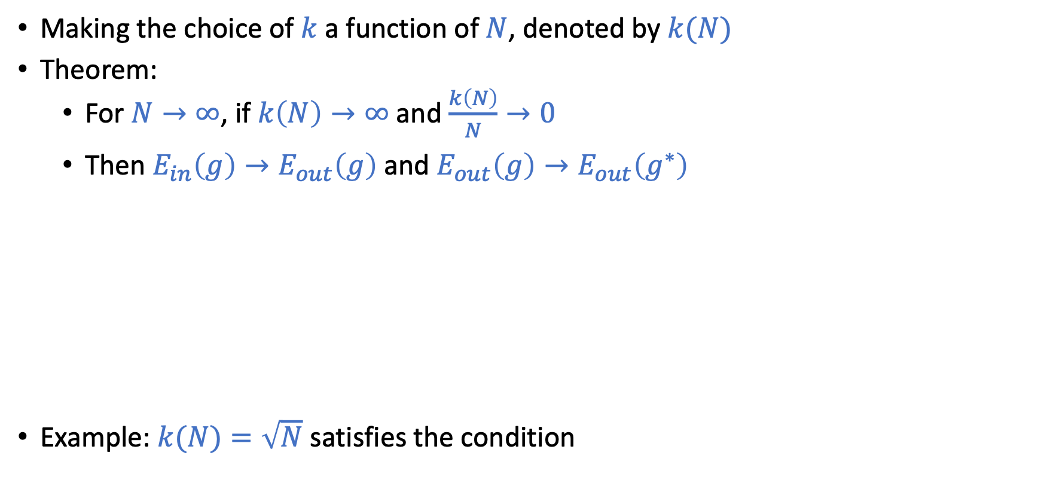
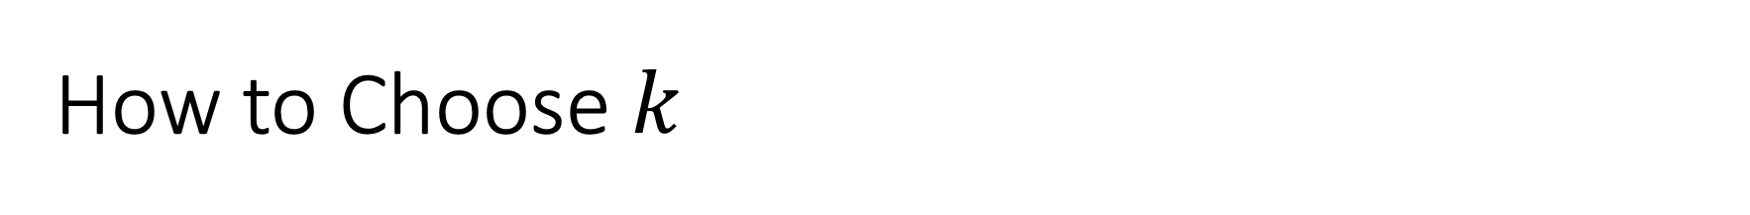
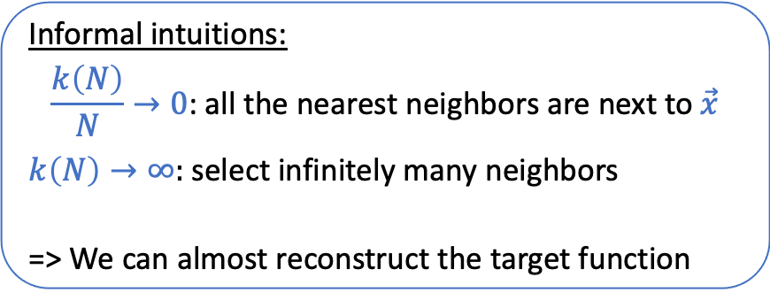
How to Choose $k$
Making the choice of $k$ a function of $N$, denoted by$k(N)$
Theorem:
For $N→∞$, if $k\left(N\right)→∞$ and $\frac{k\left(N\right)}{N}→0$
Then $E_{in}\left(g\right)→E_{out}\left(g\right)$ and $E_{out}\left(g\right)→E_{out}\left(g^{∗}\right)$
Example: $k(N)=\sqrt{N}$ satisfies the condition
Informal intuitions:
$$\frac{k\left(N\right)}{N}→0\text{: }\text{all} \text{the} \text{nearest} \text{neighbors} \text{are} \text{next} \text{to} \vec{x}$$ $k\left(N\right)→∞:$ select infinitely many neighbors
=> We can almost reconstruct the target function

Slide 12
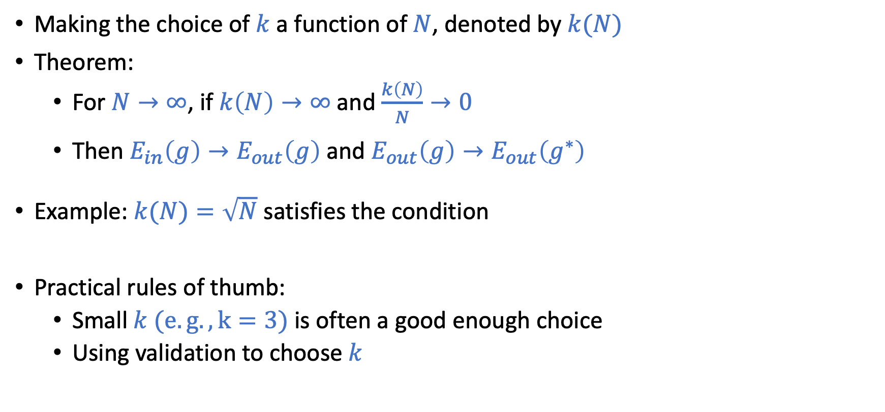
How to Choose $k$
Making the choice of $k$ a function of $N$, denoted by$k(N)$
Theorem:
For $N→∞$, if $k\left(N\right)→∞$ and $\frac{k\left(N\right)}{N}→0$
Then $E_{in}\left(g\right)→E_{out}\left(g\right)$ and $E_{out}\left(g\right)→E_{out}\left(g^{∗}\right)$
Example: $k(N)=\sqrt{N}$ satisfies the condition
Practical rules of thumb:
Small $k (e.g., k=3)$ is often a good enough choice
Using validation to choose $k$

Slide 13
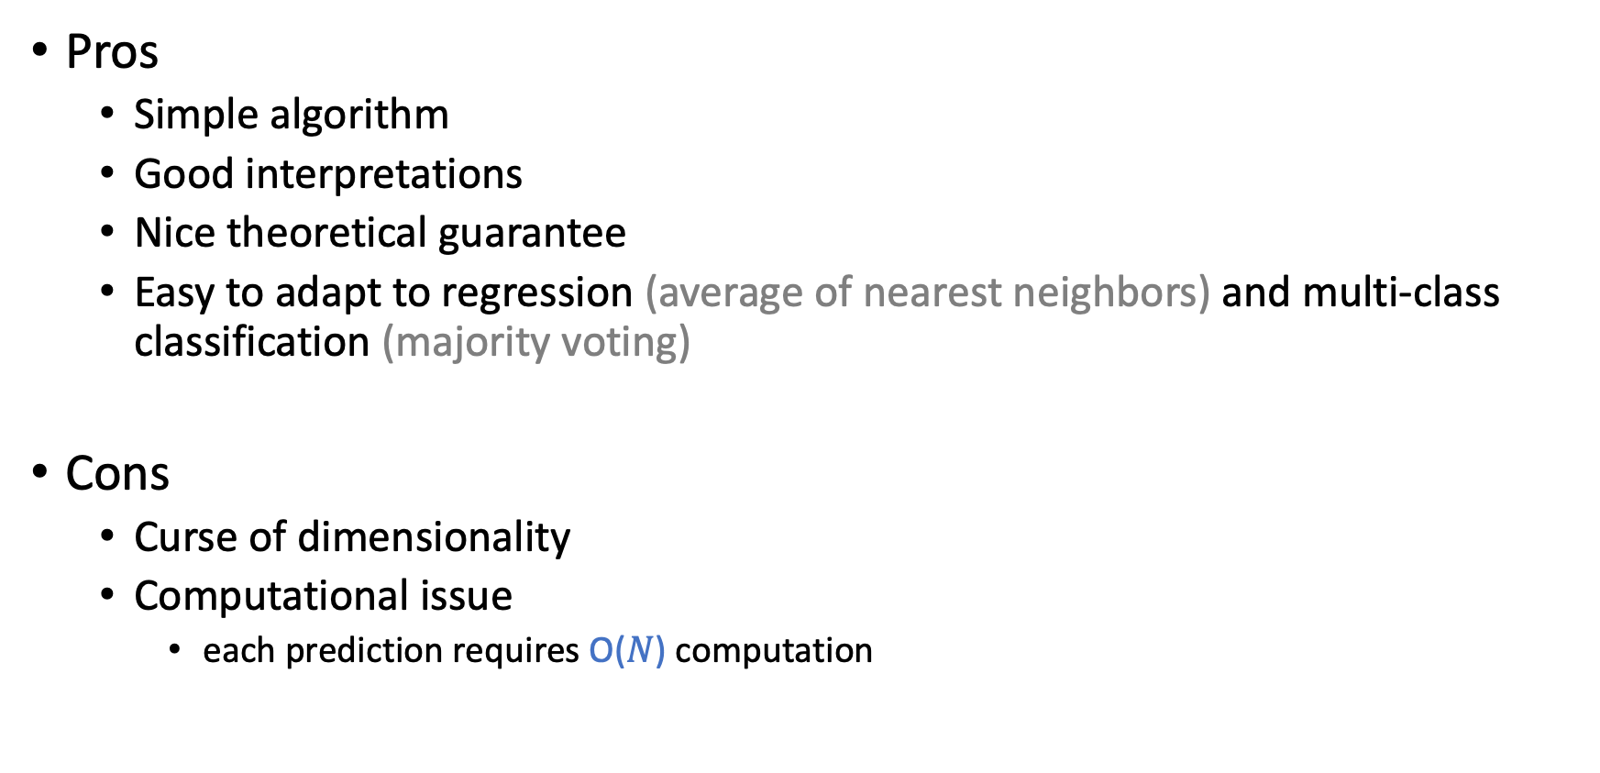
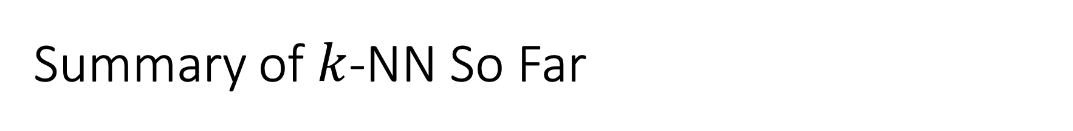
Summary of $k$-NN So Far
Pros
Simple algorithm
Good interpretations
Nice theoretical guarantee
Easy to adapt to regression (average of nearest neighbors) and multi-class classification (majority voting)
Cons
Curse of dimensionality
Computational issue
each prediction requires O($N$) computation

Slide 14
Curse of Dimensionality
Generally, higher dimensionality implies harder learning (think VC)
Things are worse with similarity-based methods
Rely on assumptions that nearby points have similar labels
As the dimension grows, most of the points will not be nearby to each other…

Slide 15
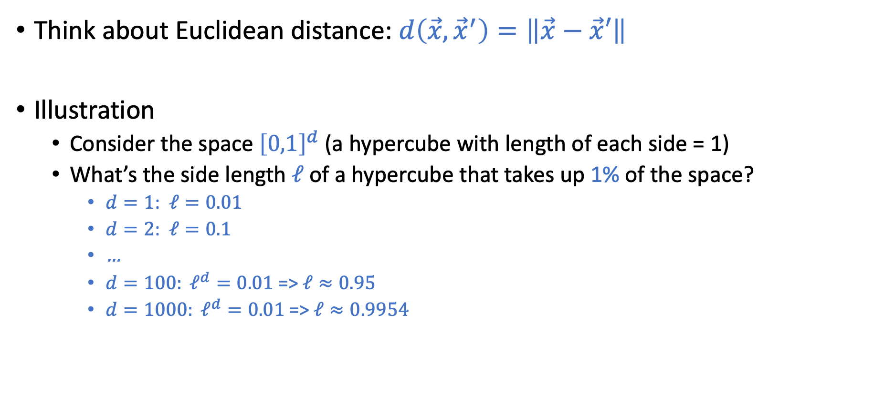
Illustration of Curse of Dimensionality
Think about Euclidean distance: $d\left(\vec{x},{\vec{x}}^{′}\right)=\left\|\vec{x}−\vec{x}′\right\|$
Illustration
Consider the space ${\left[0,1\right]}^{d}$ (a hypercube with length of each side = 1)
What’s the side length $ℓ$ of a hypercube that takes up 1% of the space?
$d=1$: $ℓ=0.01$
$d=2$: $ℓ=0.1$
…
$d=100: ℓ^{d}=0.01$ =>$ℓ≈0.95$
$d=1000: ℓ^{d}=0.01$ =>$ℓ≈0.9954$

Slide 16
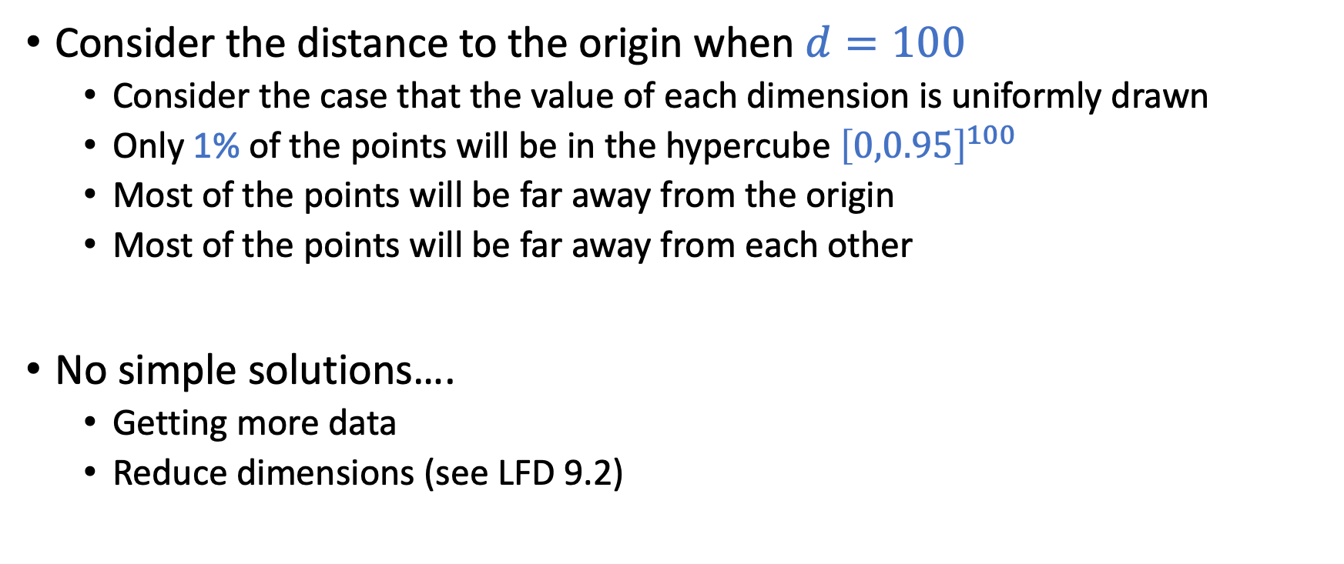
Illustration of Curse of Dimensionality
Consider the distance to the origin when $d=100$
Consider the case that the value of each dimension is uniformly drawn
Only 1% of the points will be in the hypercube ${\left[0,0.95\right]}^{100}$
Most of the points will be far away from the origin
Most of the points will be far away from each other
No simple solutions….
Getting more data
Reduce dimensions (see LFD 9.2)

Slide 17
Computational Issues for k-NN

Slide 18
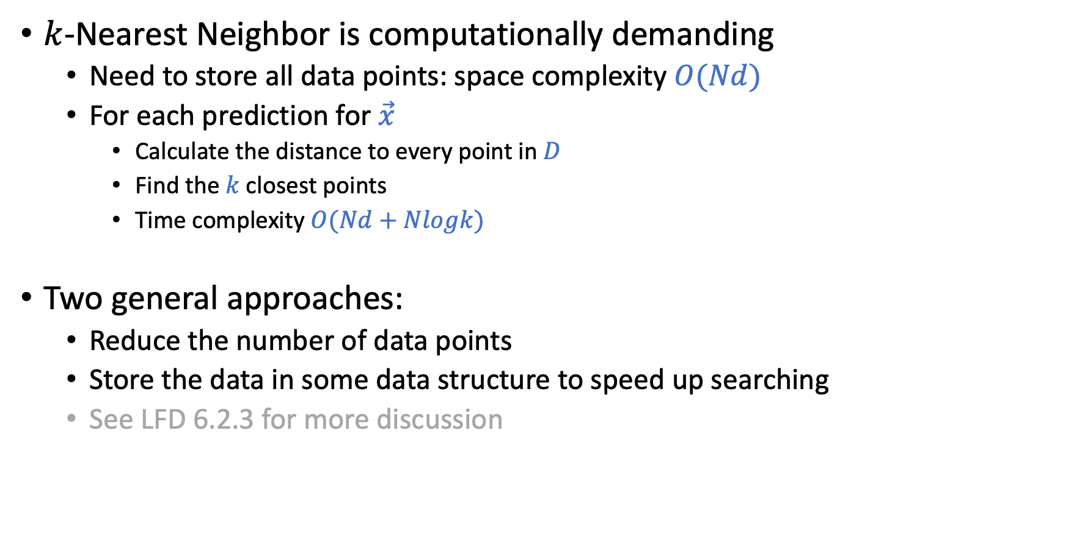
Computational Issues
$k$-Nearest Neighbor is computationally demanding
Need to store all data points: space complexity $O(Nd)$
For each prediction for $\vec{x}$
Calculate the distance to every point in $D$
Find the $k$ closest points
Time complexity $O(Nd+Nlogk)$
Two general approaches:
Reduce the number of data points
Store the data in some data structure to speed up searching
See LFD 6.2.3 for more discussion
Notes:
Using min heap to achieve NlogK
Maintain a heap with size k
Each operation is log k
So in total N log k

Slide 19
Computational Issues: Potential Solutions
Reduce the number of data points
Store the data in some data structure to speed up searching
Intuition: remove points that will not impact the decision boundary.
Generally a hard problem. But there are some heuristic approaches.
Intuition: Cluster data points
For a new data point, first find a nearest cluster. Then find the nearest points within that cluster

Slide 20
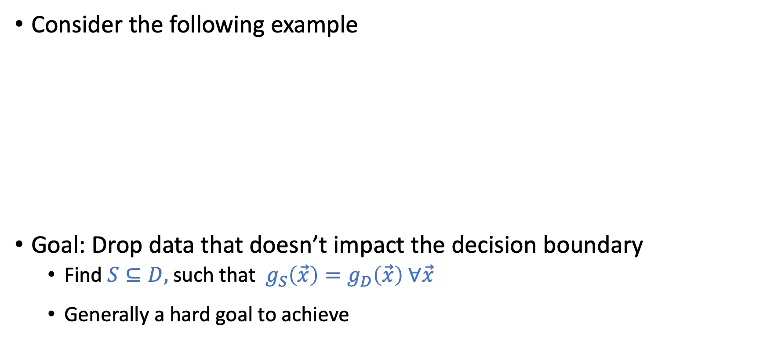
Reduce the Amount of Data
Consider the following example
Goal: Drop data that doesn’t impact the decision boundary
Find $S⊆D,$ such that $g_{S}\left(\vec{x}\right)=g_{D}\left(\vec{x}\right) ∀\vec{x}$
Generally a hard goal to achieve

Slide 21
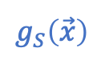
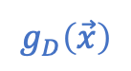

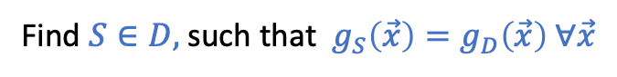
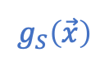
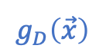
A Probably Easier Goal
Instead of making the decision boundary consistent
Aim for making the prediction on the training data consistent
Find $S∈D,$ such that $g_{S}\left(\vec{x}\right)=g_{D}\left(\vec{x}\right) ∀\vec{x}$
$$g_{D}\left(\vec{x}\right)$$
$$g_{S}\left(\vec{x}\right)$$
Find $S∈D,$ such that $g_{S}\left(\vec{x}\right)=g_{D}\left(\vec{x}\right) ∀\vec{x}∈D$
$$g_{D}\left(\vec{x}\right)$$
$$g_{S}\left(\vec{x}\right)$$

Slide 22
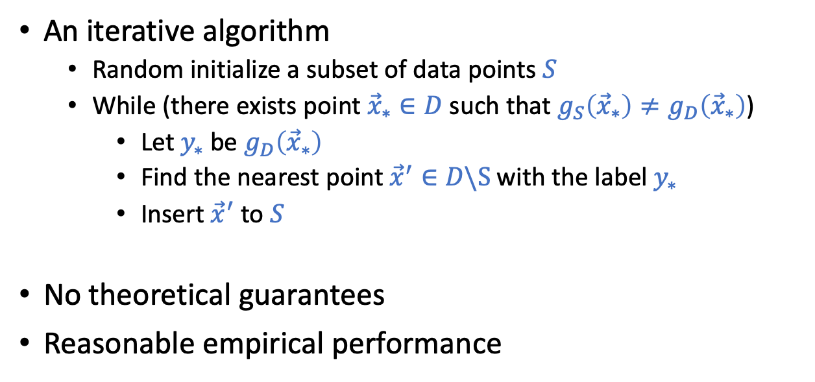
Condensed Nearest Neighbor
Goal: Find $S∈D,$ such that $g_{S}\left(\vec{x}\right)=g_{D}\left(\vec{x}\right) ∀\vec{x}∈D$
An iterative algorithm
Random initialize a subset of data points $S$
While (there exists point ${\vec{x}}_{∗}∈D$ such that $g_{S}\left({\vec{x}}_{∗}\right)≠g_{D}\left({\vec{x}}_{∗}\right)$)
Let $y_{∗}$ be $g_{D}\left({\vec{x}}_{∗}\right)$
Find the nearest point ${\vec{x}}^{′}∈D\backslash S$with the label $y_{∗}$
Insert ${\vec{x}}^{′}$ to $S$
No theoretical guarantees
Reasonable empirical performance

Slide 23
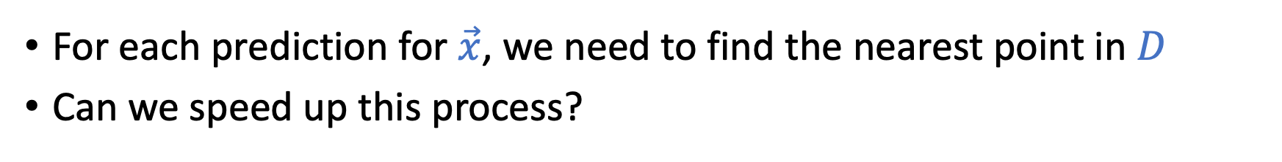
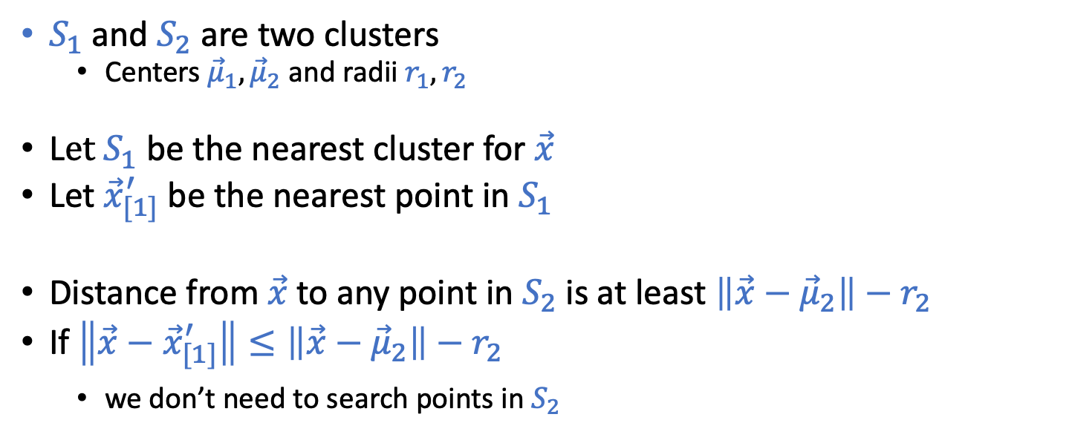
Speed Up the Search for Nearest Neighbor
For each prediction for $\vec{x}$, we need to find the nearest point in $D$
Can we speed up this process?
$S_{1}$ and $S_{2}$ are two clusters
Centers ${\vec{μ}}_{1}, {\vec{μ}}_{2}$ and radii $r_{1},r_{2}$
L$et S_{1}$ be the nearest cluster for $\vec{x}$
Let ${\vec{x}}_{[1]}^{′}$ be the nearest point in $S_{1}$
Distance from $\vec{x}$ to any point in $S_{2}$ is at least $\left\|\vec{x}−{\vec{μ}}_{2}\right\|−r_{2}$
If $\left\|\vec{x}−{\vec{x}}_{[1]}^{′}\right\|≤\left\|\vec{x}−{\vec{μ}}_{2}\right\|−r_{2}$
we don’t need to search points in $S_{2}$

Slide 24
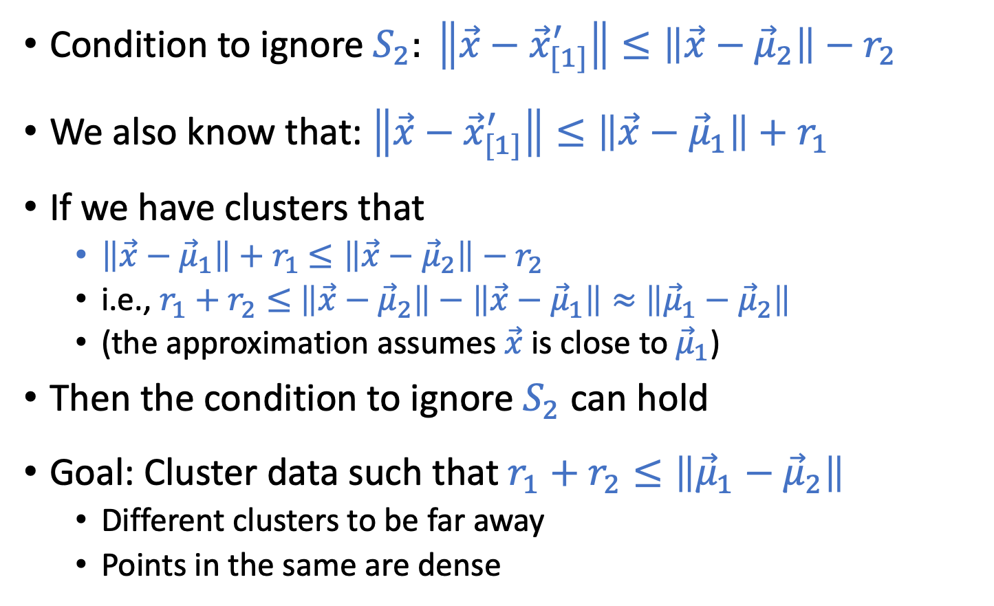
Speed Up the Search for Nearest Neighbor
Condition to ignore $S_{2}: \left\|\vec{x}−{\vec{x}}_{[1]}^{′}\right\|≤\left\|\vec{x}−{\vec{μ}}_{2}\right\|−r_{2}$
We also know that: $\left\|\vec{x}−{\vec{x}}_{[1]}^{′}\right\|≤\left\|\vec{x}−{\vec{μ}}_{1}\right\|+r_{1}$
If we have clusters that
$\left\|\vec{x}−{\vec{μ}}_{1}\right\|+r_{1}$ $≤\left\|\vec{x}−{\vec{μ}}_{2}\right\|−r_{2}$
i.e., $r_{1}+r_{2}≤$ $\left\|\vec{x}−{\vec{μ}}_{2}\right\|−\left\|\vec{x}−{\vec{μ}}_{1}\right\|≈$ $\left\|{\vec{μ}}_{1}−{\vec{μ}}_{2}\right\|$
(the approximation assumes $\vec{x}$ is close to ${\vec{μ}}_{1}$)
Then the condition to ignore $S_{2}$ can hold
Goal: Cluster data such that $r_{1}+r_{2}≤\left\|{\vec{μ}}_{1}−{\vec{μ}}_{2}\right\|$
Different clusters to be far away
Points in the same are dense

Slide 25
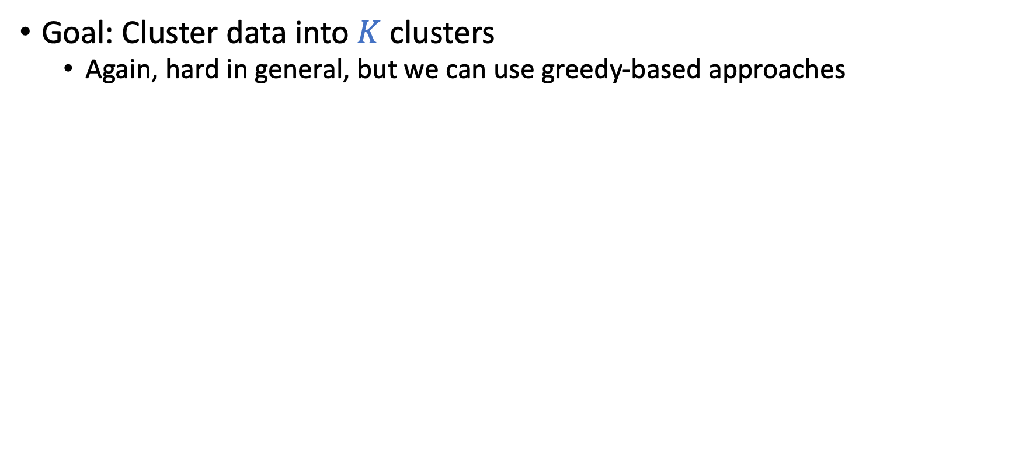
Lloyd’s Algorithm: Construct Clusters
Goal: Cluster data into $K$ clusters
Again, hard in general, but we can use greedy-based approaches
Lloyd’s Algorithm
1. Randomly pick $K$ points as centers
2. Create the Voronoi regions as clusters
3. Update the centers (calculating the mean)
4. Update the region
5. Repeat 3 and 4
This is the first (and probably the only) unsupervised learning algorithm we talk about in this course.

Slide 26
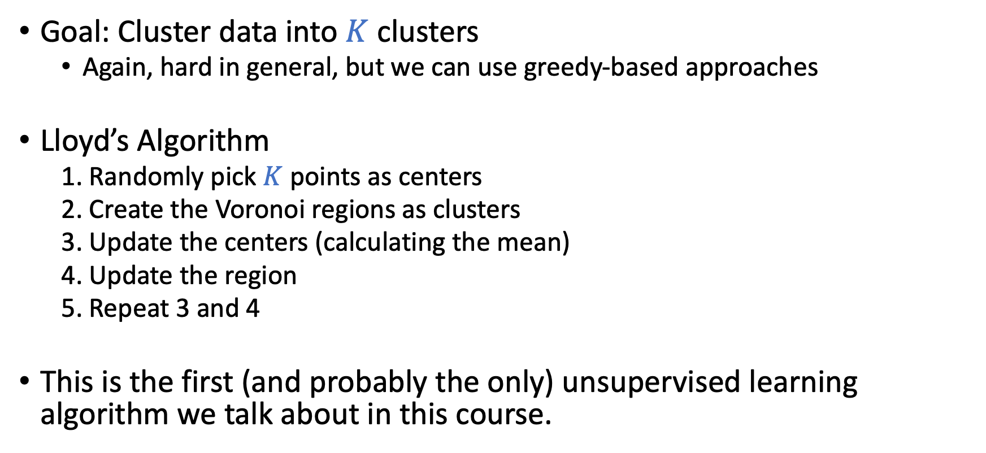
Lloyd’s Algorithm: Construct Clusters
Goal: Cluster data into $K$ clusters
Again, hard in general, but we can use greedy-based approaches
Lloyd’s Algorithm
1. Randomly pick $K$ points as centers
2. Create the Voronoi regions as clusters
3. Update the centers (calculating the mean)
4. Update the region
5. Repeat 3 and 4
This is the first (and probably the only) unsupervised learning algorithm we talk about in this course.

Slide 27
Final Remark: Nearest Neighbor is Nonparametric
Nearest Neighbor
Linear models

Slide 28
Radial Basis Functions (RBF)

Slide 29
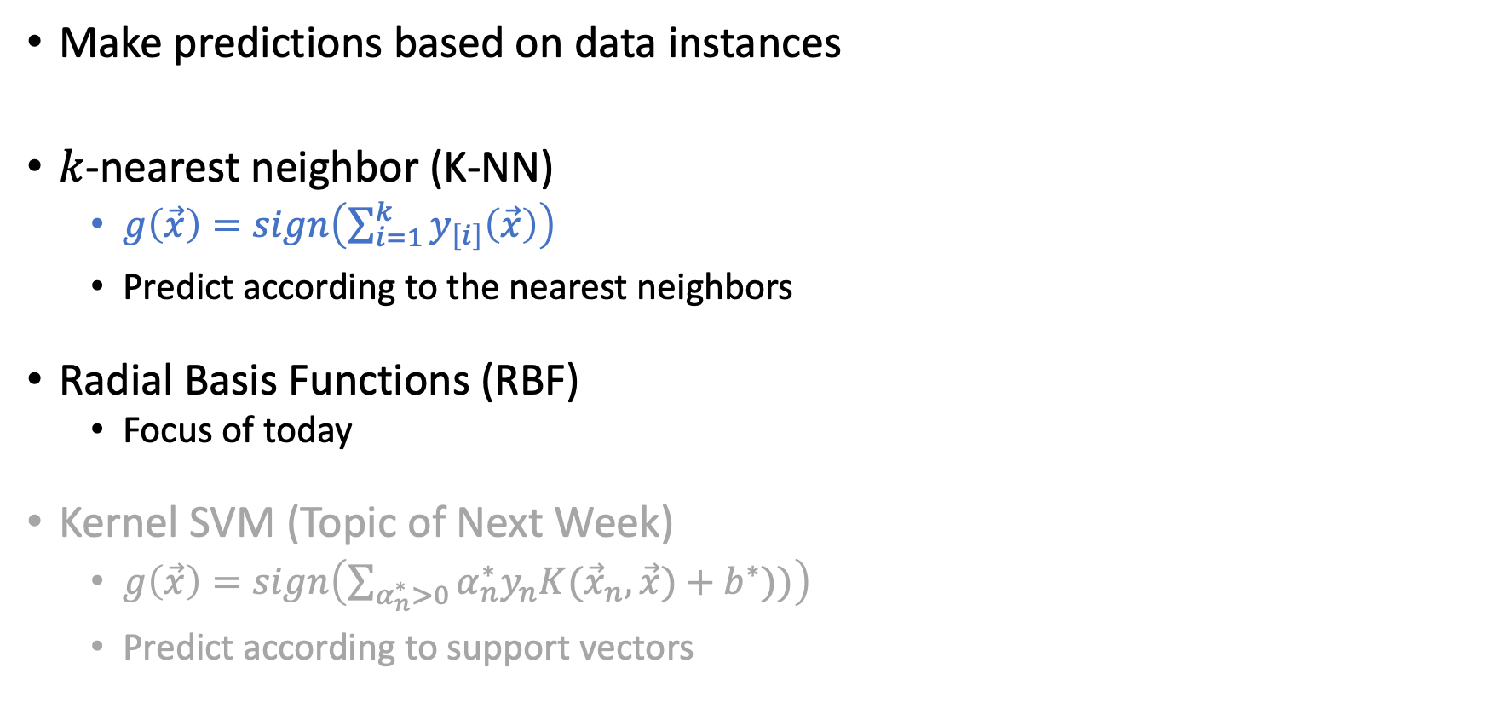
Instance-Based Learning
Make predictions based on data instances
$k$-nearest neighbor (K-NN)
$g\left(\vec{x}\right)=sign\left(\sum_{i=1}^{k}{y_{\left[i\right]}\left(\vec{x}\right)}\right)$
Predict according to the nearest neighbors
Radial Basis Functions (RBF)
Focus of today
Kernel SVM (Topic of Next Week)
$g\left(\vec{x}\right)=sign\left(\sum_{α_{n}^{∗}>0}{α_{n}^{∗}y_{n}K({\vec{x}}_{n},\vec{x})}+b^{∗}))\right)$
Predict according to support vectors

Slide 30
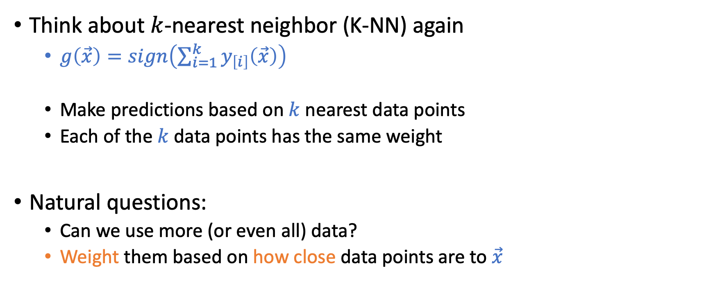
Radial Basis Functions
Think about $k$-nearest neighbor (K-NN) again
$g\left(\vec{x}\right)=sign\left(\sum_{i=1}^{k}{y_{\left[i\right]}\left(\vec{x}\right)}\right)$
Make predictions based on $k$ nearest data points
Each of the $k$data points has the same weight
Natural questions:
Can we use more (or even all) data?
Weight them based on how close data points are to $\vec{x}$

Slide 31
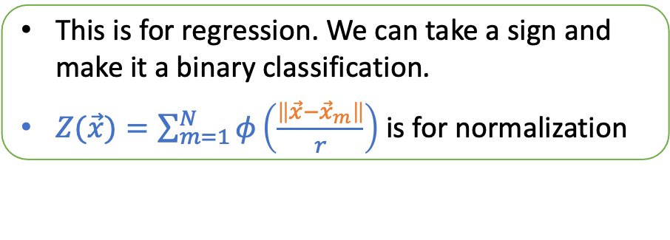
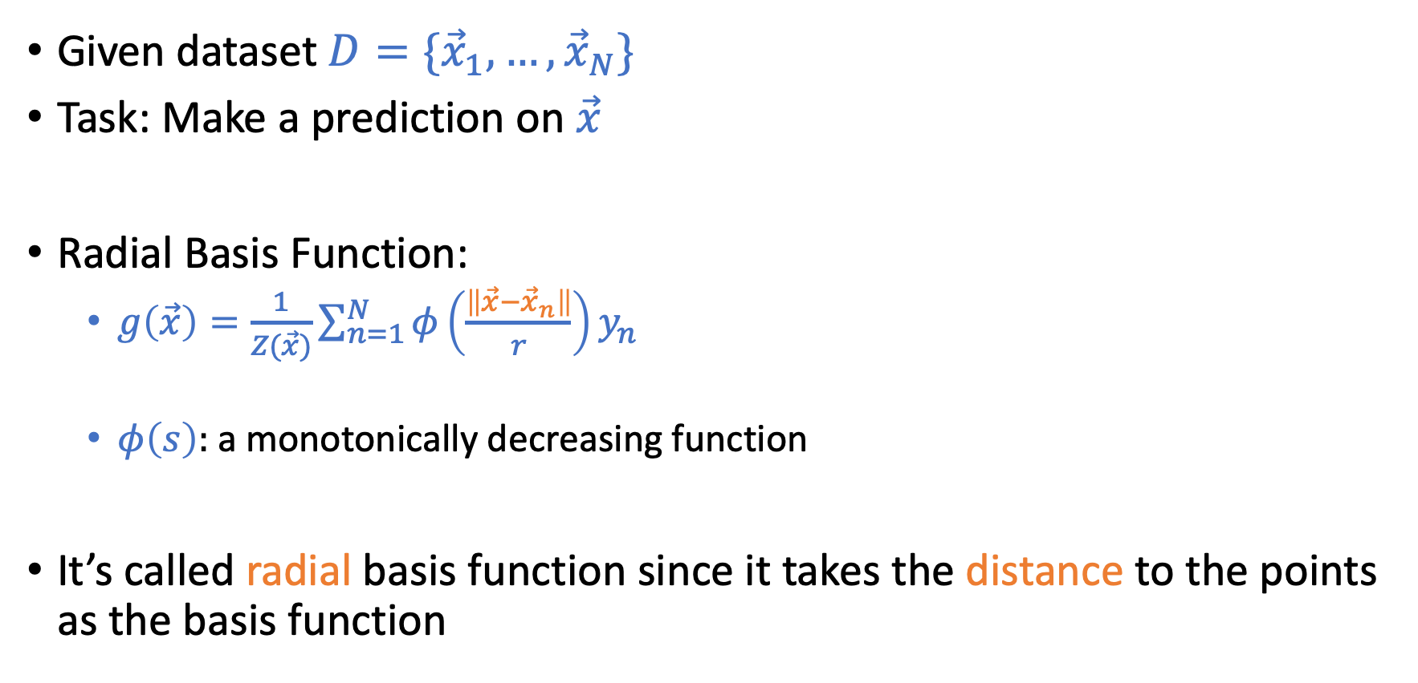
Radial Basis Functions
Given dataset $D=\{{\vec{x}}_{1},…,{\vec{x}}_{N}\}$
Task: Make a prediction on $\vec{x}$
Radial Basis Function:
$g\left(\vec{x}\right)=\frac{1}{Z(\vec{x})}\sum_{n=1}^{N}{φ\left(\frac{\left\|\vec{x}−{\vec{x}}_{n}\right\|}{r}\right)y_{n}}$
$φ\left(s\right):$a monotonically decreasing function
It’s called radial basis function since it takes the distance to the points as the basis function
This is for regression. We can take a sign and make it a binary classification.
$Z(\vec{x})=\sum_{m=1}^{N}{φ\left(\frac{\left\|\vec{x}−{\vec{x}}_{m}\right\|}{r}\right)}$ is for normalization

Slide 32
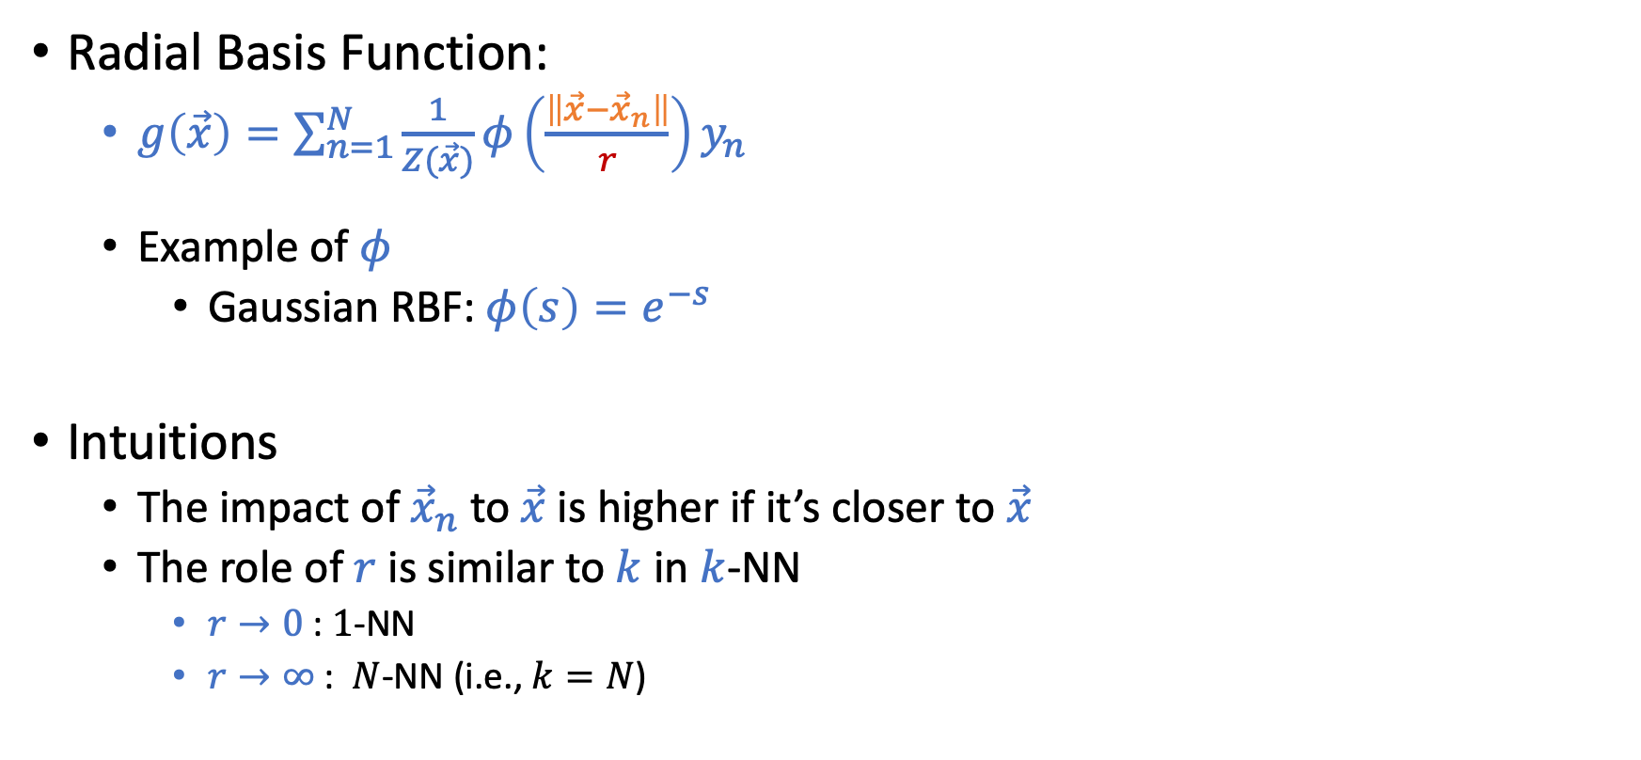
Radial Basis Functions
Radial Basis Function:
$g\left(\vec{x}\right)=\sum_{n=1}^{N}{\frac{1}{Z(\vec{x})}}φ\left(\frac{\left\|\vec{x}−{\vec{x}}_{n}\right\|}{r}\right)y_{n}$
Example of $φ$
Gaussian RBF: $φ\left(s\right)=e^{−s}$
Intuitions
The impact of ${\vec{x}}_{n}$ to $\vec{x}$is higher if it’s closer to $\vec{x}$
The role of $r$ is similar to $k$ in $k$-NN
$r→0$ : $1$-NN
$r→∞$ : $N$-NN (i.e., $k=N$)

Slide 33
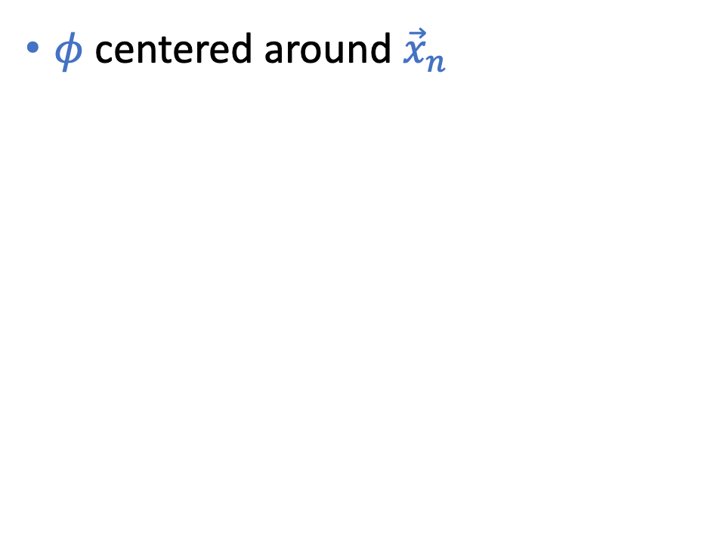
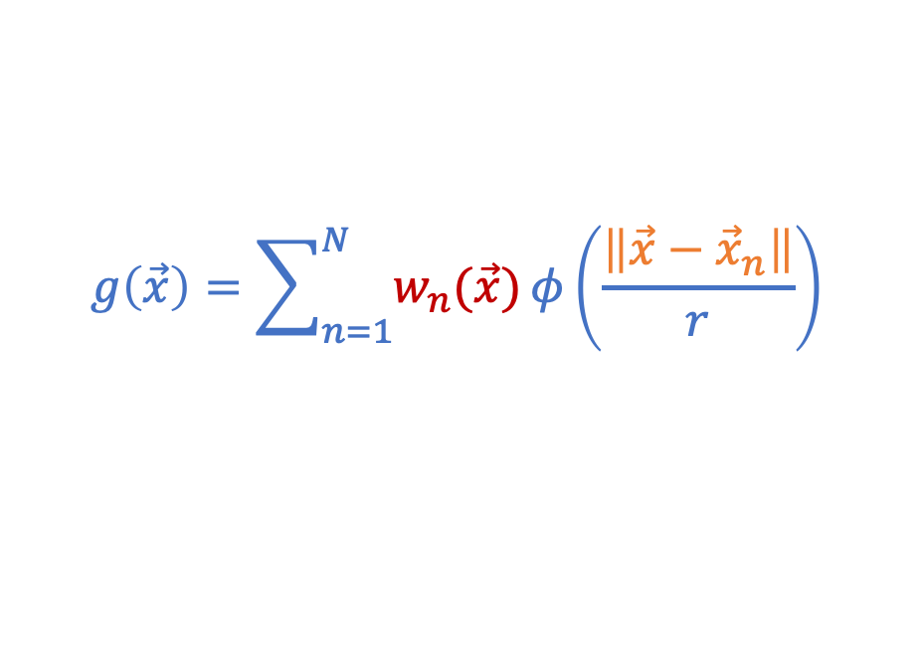
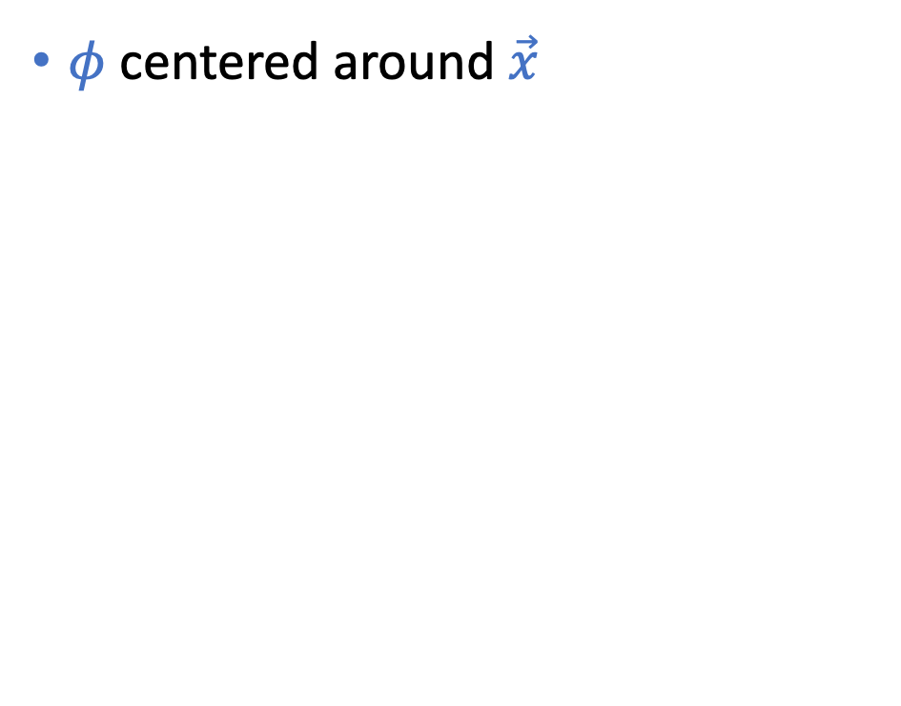
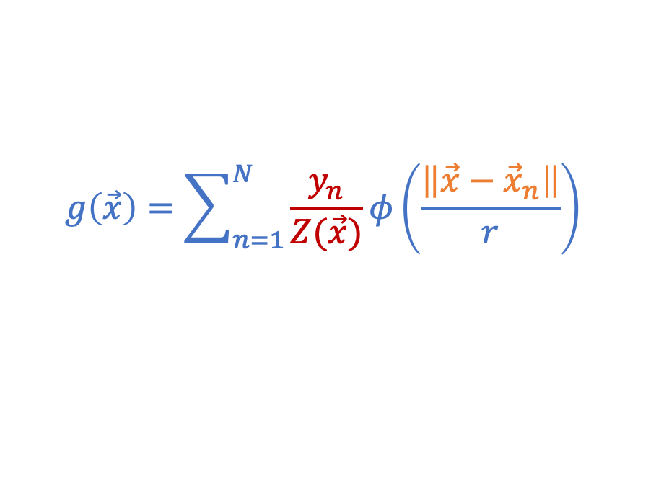
Changing the Viewpoints
$φ$ centered around $\vec{x}$
$φ$ centered around ${\vec{x}}_{n}$
$$g\left(\vec{x}\right)=\sum_{n=1}^{N}{\frac{y_{n}}{Z(\vec{x})}}φ\left(\frac{\left\|\vec{x}−{\vec{x}}_{n}\right\|}{r}\right)$$
$$g\left(\vec{x}\right)=\sum_{n=1}^{N}{w_{n}(\vec{x})}φ\left(\frac{\left\|\vec{x}−{\vec{x}}_{n}\right\|}{r}\right)$$

Slide 34
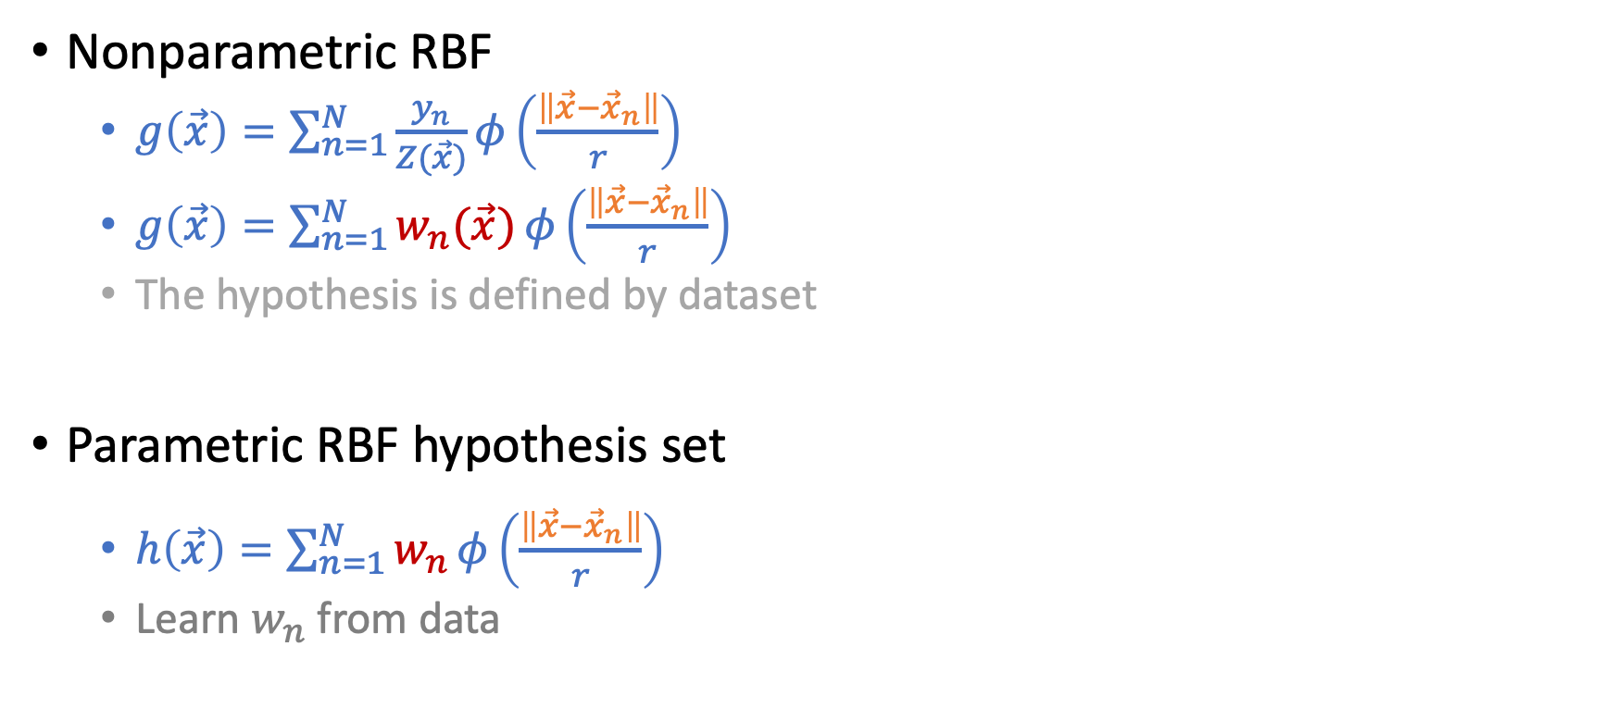
From Nonparametric to Parametric RBF
Nonparametric RBF
$g\left(\vec{x}\right)=\sum_{n=1}^{N}{\frac{y_{n}}{Z(\vec{x})}}φ\left(\frac{\left\|\vec{x}−{\vec{x}}_{n}\right\|}{r}\right)$
$g\left(\vec{x}\right)=\sum_{n=1}^{N}{w_{n}(\vec{x})}φ\left(\frac{\left\|\vec{x}−{\vec{x}}_{n}\right\|}{r}\right)$
The hypothesis is defined by dataset
Parametric RBF hypothesis set
$h\left(\vec{x}\right)=\sum_{n=1}^{N}{w_{n}}φ\left(\frac{\left\|\vec{x}−{\vec{x}}_{n}\right\|}{r}\right)$
Learn $w_{n}$ from data

Slide 35
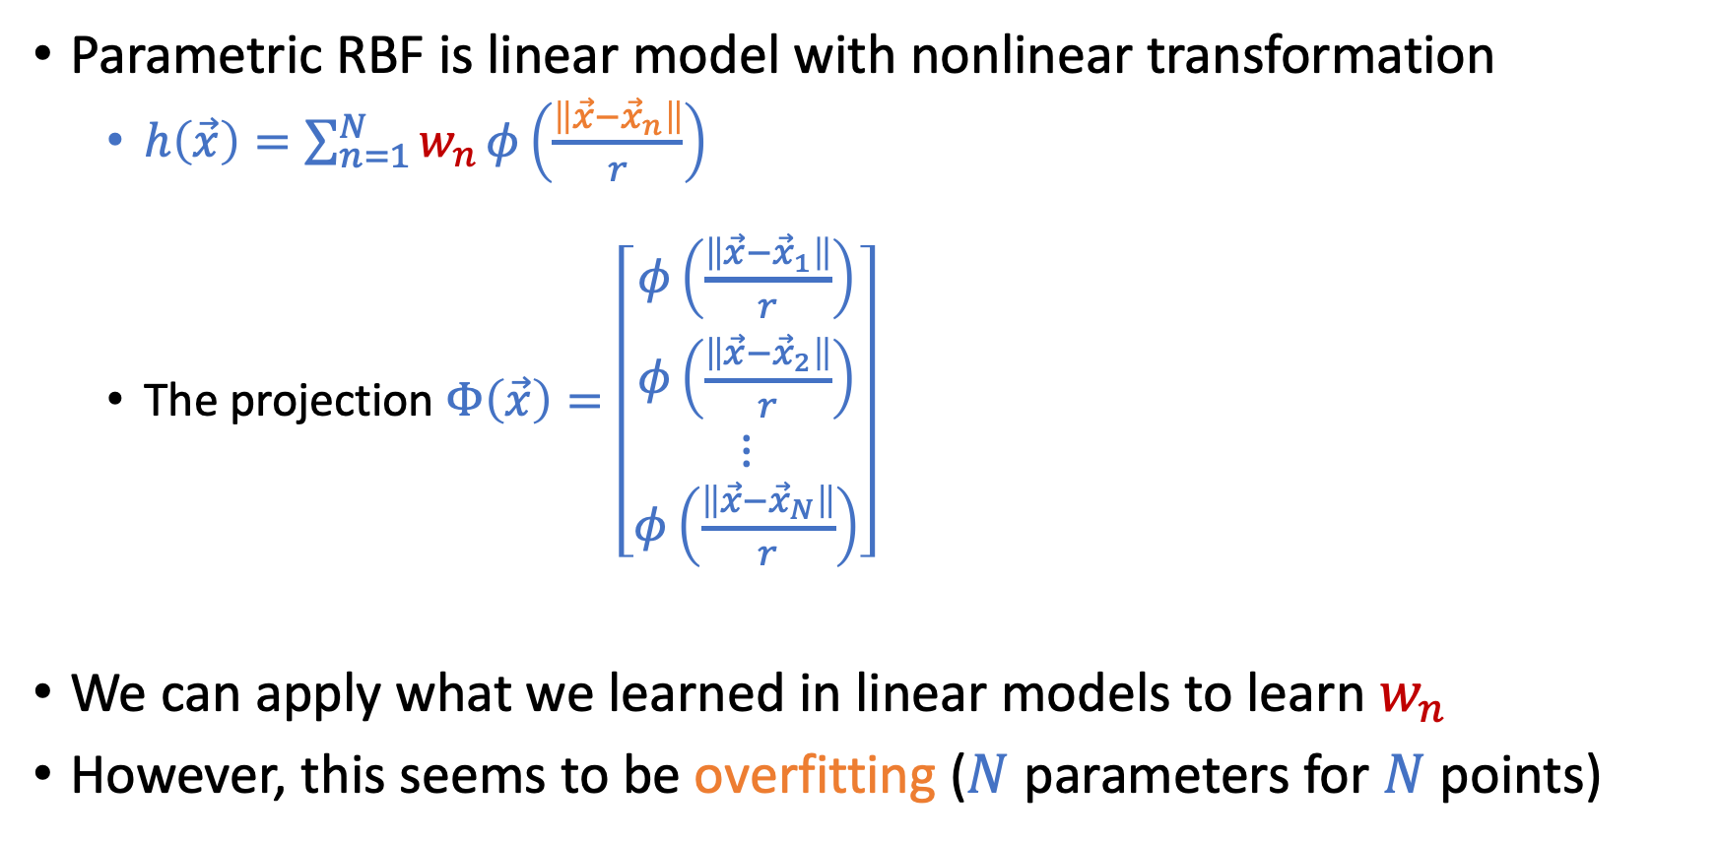
Parametric RBF => Linear Models
Parametric RBF is linear model with nonlinear transformation
$h\left(\vec{x}\right)=\sum_{n=1}^{N}{w_{n}}φ\left(\frac{\left\|\vec{x}−{\vec{x}}_{n}\right\|}{r}\right)$
The projection $Φ\left(\vec{x}\right)=\left[\begin{matrix}\begin{matrix}φ\left(\frac{\left\|\vec{x}−{\vec{x}}_{1}\right\|}{r}\right) \\ φ\left(\frac{\left\|\vec{x}−{\vec{x}}_{2}\right\|}{r}\right)\end{matrix} \\ \begin{matrix}⋮ \\ φ\left(\frac{\left\|\vec{x}−{\vec{x}}_{N}\right\|}{r}\right)\end{matrix}\end{matrix}\right]$
We can apply what we learned in linear models to learn $w_{n}$
However, this seems to be overfitting ($N$ parameters for $N$ points)

Slide 36
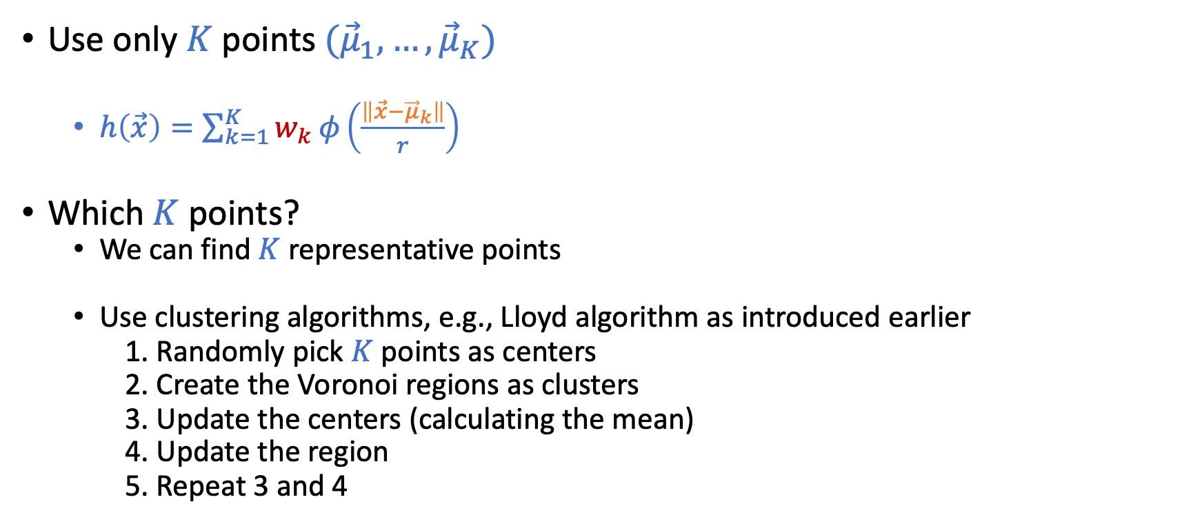

From $N$ points to $K$ points
Use only $K$ points $({\vec{μ}}_{1},…,{\vec{μ}}_{K})$
$h\left(\vec{x}\right)=\sum_{k=1}^{K}{w_{k}}φ\left(\frac{\left\|\vec{x}−{\vec{μ}}_{k}\right\|}{r}\right)$
Which $K$ points?
We can find $K$ representative points
Use clustering algorithms, e.g., Lloyd algorithm as introduced earlier
1. Randomly pick $K$ points as centers
2. Create the Voronoi regions as clusters
3. Update the centers (calculating the mean)
4. Update the region
5. Repeat 3 and 4

Slide 37
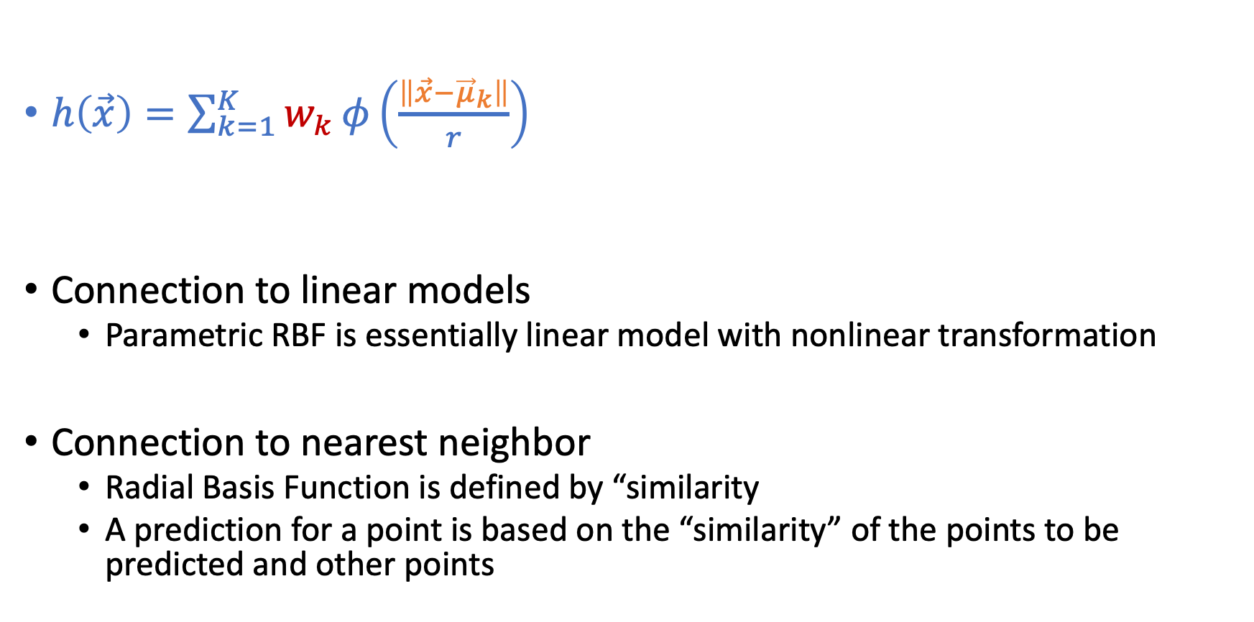
More Discussion on RBF
$h\left(\vec{x}\right)=\sum_{k=1}^{K}{w_{k}}φ\left(\frac{\left\|\vec{x}−{\vec{μ}}_{k}\right\|}{r}\right)$
Connection to linear models
Parametric RBF is essentially linear model with nonlinear transformation
Connection to nearest neighbor
Radial Basis Function is defined by “similarity
A prediction for a point is based on the “similarity” of the points to be predicted and other points

Slide 38
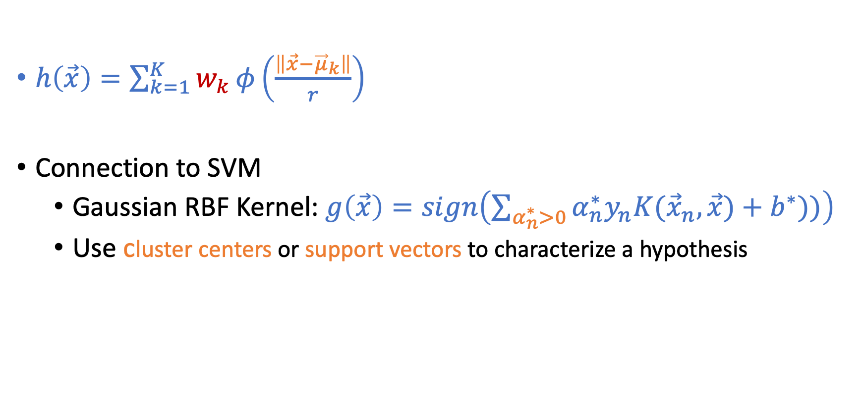
More Discussion on RBF
$h\left(\vec{x}\right)=\sum_{k=1}^{K}{w_{k}}φ\left(\frac{\left\|\vec{x}−{\vec{μ}}_{k}\right\|}{r}\right)$
Connection to SVM
Gaussian RBF Kernel: $g\left(\vec{x}\right)=sign\left(\sum_{α_{n}^{∗}>0}{α_{n}^{∗}y_{n}K({\vec{x}}_{n},\vec{x})}+b^{∗}))\right)$
Use cluster centers or support vectors to characterize a hypothesis
SVM
RBF

Slide 39
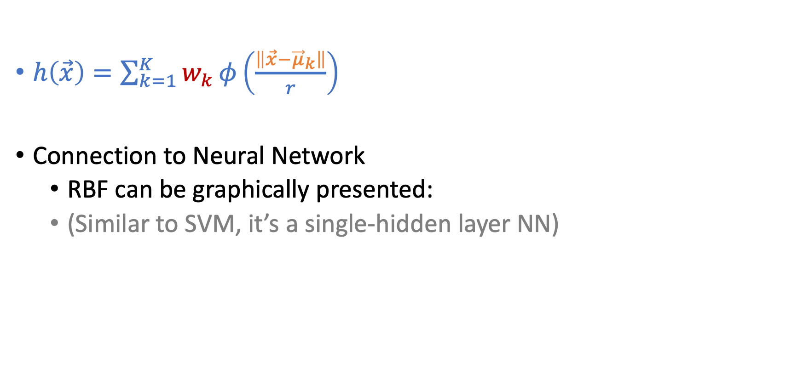
More Discussion on RBF
$h\left(\vec{x}\right)=\sum_{k=1}^{K}{w_{k}}φ\left(\frac{\left\|\vec{x}−{\vec{μ}}_{k}\right\|}{r}\right)$
Connection to Neural Network
RBF can be graphically presented:
(Similar to SVM, it’s a single-hidden layer NN)

Slide 40
Support Vector Machines (SVM)

Slide 41

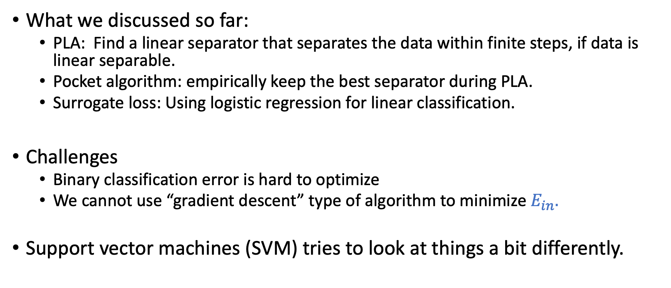
What Do We Know about Linear Classification?
What we discussed so far:
PLA: Find a linear separator that separates the data within finite steps, if data is linear separable.
Pocket algorithm: empirically keep the best separator during PLA.
Surrogate loss: Using logistic regression for linear classification.
Challenges
Binary classification error is hard to optimize
We cannot use “gradient descent” type of algorithm to minimize $E_{in}.$
Support vector machines (SVM) tries to look at things a bit differently.

Slide 42
Linear Classification
Which separator would you choose?
Probably the right one. Why?

Slide 43
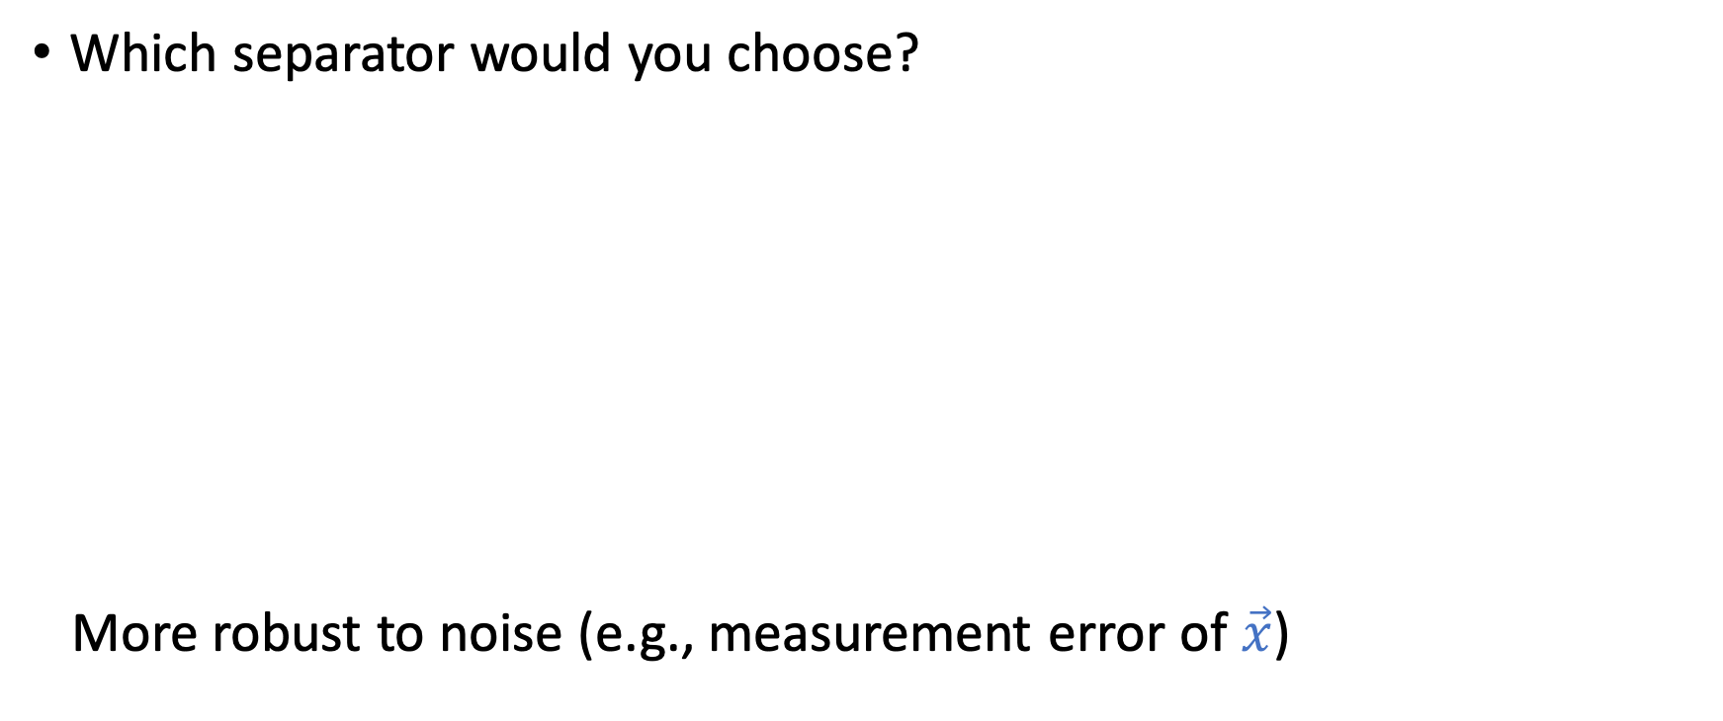
Linear Classification
Which separator would you choose?
More robust to noise (e.g., measurement error of $\vec{x}$)

Slide 44
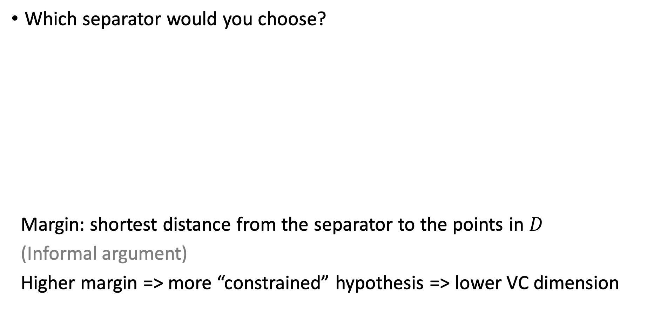
Linear Classification
Which separator would you choose?
Margin: shortest distance from the separator to the points in $D$
(Informal argument)
Higher margin => more “constrained” hypothesis => lower VC dimension
Margin

Slide 45
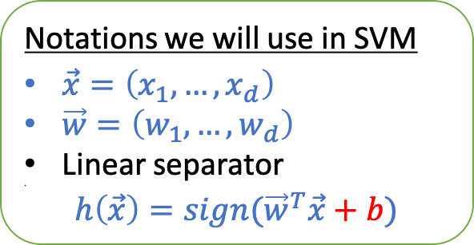
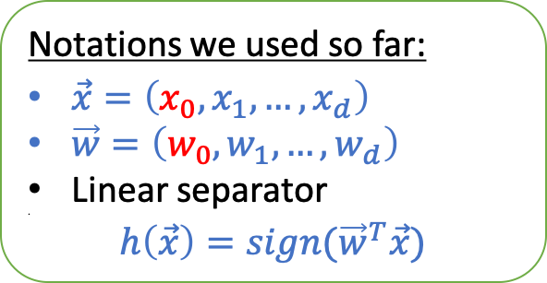

Support Vector Machine
Goal:
Find the max-margin linear separator that separates the data
Recall the goal of PLA: Find the linear separator that separates the data
Notations:
Notations we used so far:
$\vec{x}=\left(x_{0},x_{1},…,x_{d}\right)$
$\vec{w}=\left(w_{0},w_{1},…,w_{d}\right)$
Linear separator
$h\left(\vec{x}\right)=sign({\vec{w}}^{T}\vec{x})$
Notations we will use in SVM
$\vec{x}=\left(x_{1},…,x_{d}\right)$
$\vec{w}=\left(w_{1},…,w_{d}\right)$
Linear separator
$h\left(\vec{x}\right)=sign({\vec{w}}^{T}\vec{x}+b)$
Separating the bias/intercept $b$ is important for us to characterize the margin.
We will use $(\vec{w},b)$ to characterize the hypothesis

Slide 46




Relevant Review of Linear Algebra
Claim: $\vec{w}$ is the norm vector of the hyperplane ${\vec{w}}^{T}\vec{x}+b=0$
$$\vec{w}$$
$${\vec{x}}^{′}$$
$${\vec{x}}^{”}$$
$${\vec{w}}^{T}\vec{x}+b=0$$

Slide 47

Relevant Review of Linear Algebra
Claim: $\vec{w}$ is the norm vector of the hyperplane ${\vec{w}}^{T}\vec{x}+b=0$
Consider any two points ${\vec{x}}^{′}$ and $\vec{x}”$ on the hyperplane
${\vec{w}}^{T}\vec{x}′+b=0$
${\vec{w}}^{T}\vec{x}”+b=0$
Combining the above
${\vec{w}}^{T}\left({\vec{x}}^{′}−\vec{x}”\right)=0$
$\vec{w}$ is orthogonal to the hyperplane
$\vec{w}$ is the norm vector of the hyperplane
$$\vec{w}$$
$${\vec{x}}^{′}$$
$${\vec{x}}^{”}$$
$${\vec{w}}^{T}\vec{x}+b=0$$

Slide 48





Relevant Review of Linear Algebra
What is the distance between a point ${\vec{x}}_{0}$ and a hyperplane ${\vec{w}}^{T}\vec{x}+b=0$
$${\vec{x}}_{0}$$
$$\vec{w}$$
$${\vec{x}}^{′}$$
$${\vec{w}}^{T}\vec{x}+b=0$$

Slide 49

Relevant Review of Linear Algebra
What is the distance between a point ${\vec{x}}_{0}$ and a hyperplane ${\vec{w}}^{T}\vec{x}+b=0$
Consider an arbitrary point $\vec{x}′$ on the hyperplane
Distance between the point ${\vec{x}}_{0}$ and the hyperplane
$dist({\vec{x}}_{0},\vec{w},b)=\left|\frac{{\vec{w}}^{T}}{\left\|\vec{w}\right\|}({\vec{x}}_{0}−\vec{x}′)\right|$
$dist({\vec{x}}_{0},\vec{w},b)=\left|\frac{1}{\left\|\vec{w}\right\|}({\vec{w}}^{T}{\vec{x}}_{0}−{\vec{w}}^{T}\vec{x}′)\right|$
$dist({\vec{x}}_{0},\vec{w},b)=$ $\left|\frac{1}{\left\|\vec{w}\right\|}({\vec{w}}^{T}{\vec{x}}_{0}+b)\right|$
$${\vec{x}}_{0}$$
$$\vec{w}$$
$${\vec{x}}^{′}$$
$${\vec{w}}^{T}\vec{x}+b=0$$

Slide 50

Outline of Our Discussion
Assume data is linearly separable
Formulate the hard-margin SVM
When data is not linearly separable
Tolerate some noise
Soft-margin SVM
Given $D$, find separator $(\vec{w},b)$ that
maximize margin$(\vec{w},b)$
s.t. all points in $D$ is correctly classified
Nonlinear transform
Dual formulation and kernel tricks

Slide 51
Hard-Margin SVM

Slide 52



Hard-Margin SVM
Goal
Given $D=\left\{\left({\vec{x}}_{1},y_{1}\right),…,\left({\vec{x}}_{N},y_{N}\right)\right\}$ that is linearly separable
Find separator $(\vec{w},b)$ that (1) maximizes the margin and (2) separates $D$
$(\vec{w},b)$ separates $D$ (making correct predictions for all points in $D$)
$y_{n}=$ $sign({\vec{w}}^{T}{\vec{x}}_{n}+b)$ for all $n$
$y_{n}\left({\vec{w}}^{T}{\vec{x}}_{n}+b\right)≥0$ for all $n$
Margin: shortest distance from the separator to points in $D$
$\text{margin}\left(\vec{w},b\right)=min_{n}{dist({\vec{x}}_{n},\vec{w},b)}$
$\text{margin}\left(\vec{w},b\right)=min_{n}\left|\frac{1}{\left\|\vec{w}\right\|}({\vec{w}}^{T}{\vec{x}}_{n}+b)\right|$
$\text{margin}\left(\vec{w},b\right)=min_{n}{\frac{1}{\left\|\vec{w}\right\|}}y_{n}({\vec{w}}^{T}{\vec{x}}_{n}+b)$
$dist({\vec{x}}_{0},\vec{w},b)=$ $\left|\frac{1}{\left\|\vec{w}\right\|}({\vec{w}}^{T}{\vec{x}}_{0}−b)\right|$
$y_{n}∈\{−1,+1\}$ and $y_{n}\left({\vec{w}}^{T}{\vec{x}}_{n}+b\right)≥0$

Slide 53


Hard-Margin SVM
Goal
Given $D=\left\{\left({\vec{x}}_{1},y_{1}\right),…,\left({\vec{x}}_{N},y_{N}\right)\right\}$ that is linearly separable
Find separator $(\vec{w},b)$ that (1) maximizes the margin and (2) separates $D$
Formulate it as a constrained optimization problem
$${\text{maximize}}_{\vec{w},b} \text{margin}\left(\vec{w},b\right) \\ \text{subject} \text{to} y_{n}\left({\vec{w}}^{T}{\vec{x}}_{n}+b\right)≥0, ∀n \\ \text{margin}\left(\vec{w},b\right)=min_{n}{\frac{1}{\left\|\vec{w}\right\|}}y_{n}({\vec{w}}^{T}{\vec{x}}_{n}+b)$$

Slide 54


Hard-Margin SVM
The constrained optimization problem
normalizing $(\vec{w},b)$
Note that ${\vec{w}}^{T}\vec{x}+b=0$ is equivalent to $c{\vec{w}}^{T}\vec{x}+cb=0$ for any $c$
We will normalize $(\vec{w},b)$ such that $min_{n}{y_{n}({\vec{w}}^{T}{\vec{x}}_{n}+b})=1$
$\text{margin}\left(\vec{w},b\right)=\frac{1}{\left\|\vec{w}\right\|}$
$y_{n}\left({\vec{w}}^{T}{\vec{x}}_{n}+b\right)≥1$, $∀n$
$${\text{maximize}}_{\vec{w},b} \text{margin}\left(\vec{w},b\right) \\ \text{subject} \text{to} y_{n}\left({\vec{w}}^{T}{\vec{x}}_{n}+b\right)≥0, ∀n \\ \text{margin}\left(\vec{w},b\right)=min_{n}{\frac{1}{\left\|\vec{w}\right\|}}y_{n}({\vec{w}}^{T}{\vec{x}}_{n}+b)$$

Slide 55


Hard-Margin SVM
The constrained optimization problem
Some final adjustments
$${\text{maximize}}_{\vec{w},b} \frac{1}{\left\|\vec{w}\right\|} \\ \text{subject} \text{to} y_{n}\left({\vec{w}}^{T}{\vec{x}}_{n}+b\right)≥1, ∀n$$
$${\text{minimize}}_{\vec{w},b} \frac{1}{2}{\vec{w}}^{T}\vec{w} \\ \text{subject} \text{to} y_{n}\left({\vec{w}}^{T}{\vec{x}}_{n}+b\right)≥1, ∀n$$

Slide 56


Final Form of Hard-Margin SVM
$${\text{minimize}}_{\vec{w},b} \frac{1}{2}{\vec{w}}^{T}\vec{w} \\ \text{subject} \text{to} y_{n}\left({\vec{w}}^{T}{\vec{x}}_{n}+b\right)≥1, ∀n$$
How to solve it?
Hard-margin SVM is a Quadratic Program
Standard form of Quadratic Program (QP)
${\text{minimize}}_{\vec{u}} \frac{1}{2}{\vec{u}}^{T}Q\vec{u}+{\vec{p}}^{T}\vec{u}$ $\text{subject} \text{to} A\vec{u}≥\vec{c}$
There exist efficient QP solvers we can utilize

Slide 57
Short Break and Questions

Slide 58


Connection to Regularization
Weight decay regularization in linear model
Another way to look at SVM
minimize $E_{in}\left(\vec{w}\right)$
subject to ${\vec{w}}^{T}\vec{w}≤C$
minimize ${\vec{w}}^{T}\vec{w}$
subject to $E_{in}\left(\vec{w}\right)=0$

Slide 59


Support Vectors
We call the points closest to the separator (candidate) support vectors
Since they support the separator
What are the math properties of support vectors?
They are the points that the equality holds in the constraints
If ${\vec{x}}_{n}$ is a support vector, $y_{n}\left({\vec{w}}^{T}{\vec{x}}_{n}+b\right)=1$
Removing the non-support vectors will not impact the linear separator
$${\text{minimize}}_{\vec{w},b} \frac{1}{2}{\vec{w}}^{T}\vec{w} \\ \text{subject} \text{to} y_{n}\left({\vec{w}}^{T}{\vec{x}}_{n}+b\right)≥1, ∀n$$

Slide 60

Leave-One-Out Cross Validation (LOOCV)
Two things we know so far
Removing non-support vectors will not impact the separator
LOOCV error (when not used for model selection) is an unbiased estimate of $E_{out}(N−1)$ ($E_{out}$ when trained on $N−1$ points)
What’s the LOOCV error for SVM?
$E_{LOOCV}≤\frac{\# \text{support} \text{vectors}}{N}$
Note that we know # support vectors after training
Count # points that satisfy $y_{n}\left({\vec{w}}^{T}{\vec{x}}_{n}+b\right)=1$
Another method to estimate/bound $E_{out}$ (counting # support vectors)

Slide 61
What if Data is Not Linearly Separable

Slide 62
Non-Separable Data
Two scenarios
Tolerate some noise
Soft-Margin SVM
Nonlinear transform
Dual formulation and kernel tricks

Slide 63

Soft-Margin SVM
Intuition: We want to tolerate small noises while maintaining large margin
For each point $({\vec{x}}_{n},y_{n})$, we allow a deviation $ξ_{n}≥0$
Instead of requiring $y_{n}\left({\vec{w}}^{T}{\vec{x}}_{n}+b\right)≥1$
The constraint becomes
$y_{n}\left({\vec{w}}^{T}{\vec{x}}_{n}+b\right)≥1−ξ_{n}$
We add a penalty for each deviation
Total penalty $C\sum_{n=1}^{N}{ξ_{n}}$

Slide 64



Soft-Margin SVM
The constraint becomes: $y_{n}\left({\vec{w}}^{T}{\vec{x}}_{n}+b\right)≥1−ξ_{n}$
We add a penalty for each deviation: Total penalty $C\sum_{n=1}^{N}{ξ_{n}}$
$${\text{minimize}}_{\vec{w},b,\vec{ξ}} \frac{1}{2}{\vec{w}}^{T}\vec{w}+C\sum_{n=1}^{N}{ξ_{n}} \\ \text{subject} \text{to} y_{n}\left({\vec{w}}^{T}{\vec{x}}_{n}+b\right)≥1−ξ_{n}, ∀n$$
$ξ_{n}≥0$, $∀n$
Remarks:
$C$ is a hyper-parameter we can choose, e.g., using validation
Soft-margin SVM is still a Quadratic Program, with efficient solvers

Slide 65


Impacts of $C$ in Soft-Margin SVM
Large $C$ => less tolerate to noise, having smaller margin

Slide 66
What if Tolerating Small Noises Is Not Enough
Nonlinear transform
We can apply standard nonlinear transformation procedure we talked about before
In SVM, we can combine the ideas of dual formulation and kernel tricks for the transformation
This is one of the key ingredients that makes SVM powerful

